Slide 1

Mathe III
Ralf Herbrich
Bayesianische Statistik

Slide 2
Overview
Bayesian Probabilities and Conjugacy
Graphical Models
The Sum-Product Algorithm
Bayesian Ranking: TrueSkill
Information Theory
Arithmetic Coding

Slide 3
Overview
Bayesian Probabilities and Conjugacy
Graphical Models
The Sum-Product Algorithm
Bayesian Ranking: TrueSkill
Information Theory
Arithmetic Coding

Slide 4

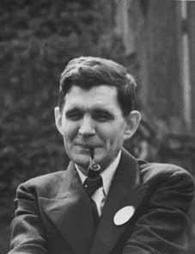
Frequentist vs. Subjective Probabilities
Kolmogorov (1933): The rules of probability for sets follow from the following 3 axioms
$P\left(A\right)≥0$ for all $A⊆S$
$P\left(S\right)=1$
$P\left(\bigcup_{i}{A_{i}}\right)=\sum_{i}{P\left(A_{i}\right)}$ if for all $i≠j:A_{i}∩A_{j}=∅$
Cox (1944): The rules of probability for logic follow from the following 3 axioms
$P\left(A\right)∈\left[0,1\right]$ for all logical statements $A$
$P\left(A\right)$ is independent of how the statement is represented
If $P\left(A|C^{′}\right)>P\left(A|C\right)$ and $P\left(B|A∧C^{′}\right)=P\left(B|A∧C\right)$ then
$$P\left(A∧B|C^{′}\right)≥P\left(A∧B|C\right)$$
Andrey Kolmogorov (1903 – 1987)
Richard Threlkeld Cox (1898 – 1991)

Slide 5
Frequentist vs. Subjectivist Interpretation
Frequentist Interpretation
Probability is a property of the event (“it rains tomorrow in Bangalore”)
Is operationalized by repeated experiments
Typically used by scientists and engineers
Subjective Interpretation
Probability is an expression of belief of the person makes a statement
Is subjective and people-dependent: Two people with identical data can come to different probabilities
Typically used by philosophers and economists
Probability is not a physical measure but a thought model for randomness!
The mathematical rules for probability are identical for both interpretations!

Slide 6

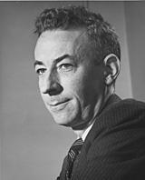
Probability Distributions: Conjugacy
Bayes Rule for Random Variables. For any probability distribution $p$ over two random variables $X$ and $Θ$, it holds
$$p\left(θ|x\right)=\frac{p\left(x|θ\right)⋅p\left(θ\right)}{p\left(x\right)}$$
Conjugacy. A family ${\left\{p\left(x,θ\right)\right\}}_{x,θ}$ is conjugate if the posterior $p\left(θ|x\right)$ is part of the same family as the prior $p\left(θ\right)$ for any value of $x$.
Big Advantage: Computing the exact posterior is computationally efficient!
Likelihood
$$p\left(x,θ\right)$$
Howard Raiffa (1924 – 2016)
Posterior
Prior
Likelihood $p(x|θ)$ | Model Parameter | Conjugate Prior $p(θ)$
$$Ber\left(x;π\right)$$ | $$π$$ | $$Beta\left(π;α,β\right)$$
$$Bin\left(x;n,π\right)$$ | $$π$$ | $$Beta\left(π;α,β\right)$$
$$𝒩\left(x;μ,σ^{2}\right)$$ | $$μ,σ^{2}$$ | $$𝒩\left(μ;m,s^{2}\right)$$
Robert Osher Schlaifer (1914 – 1994)

Slide 7
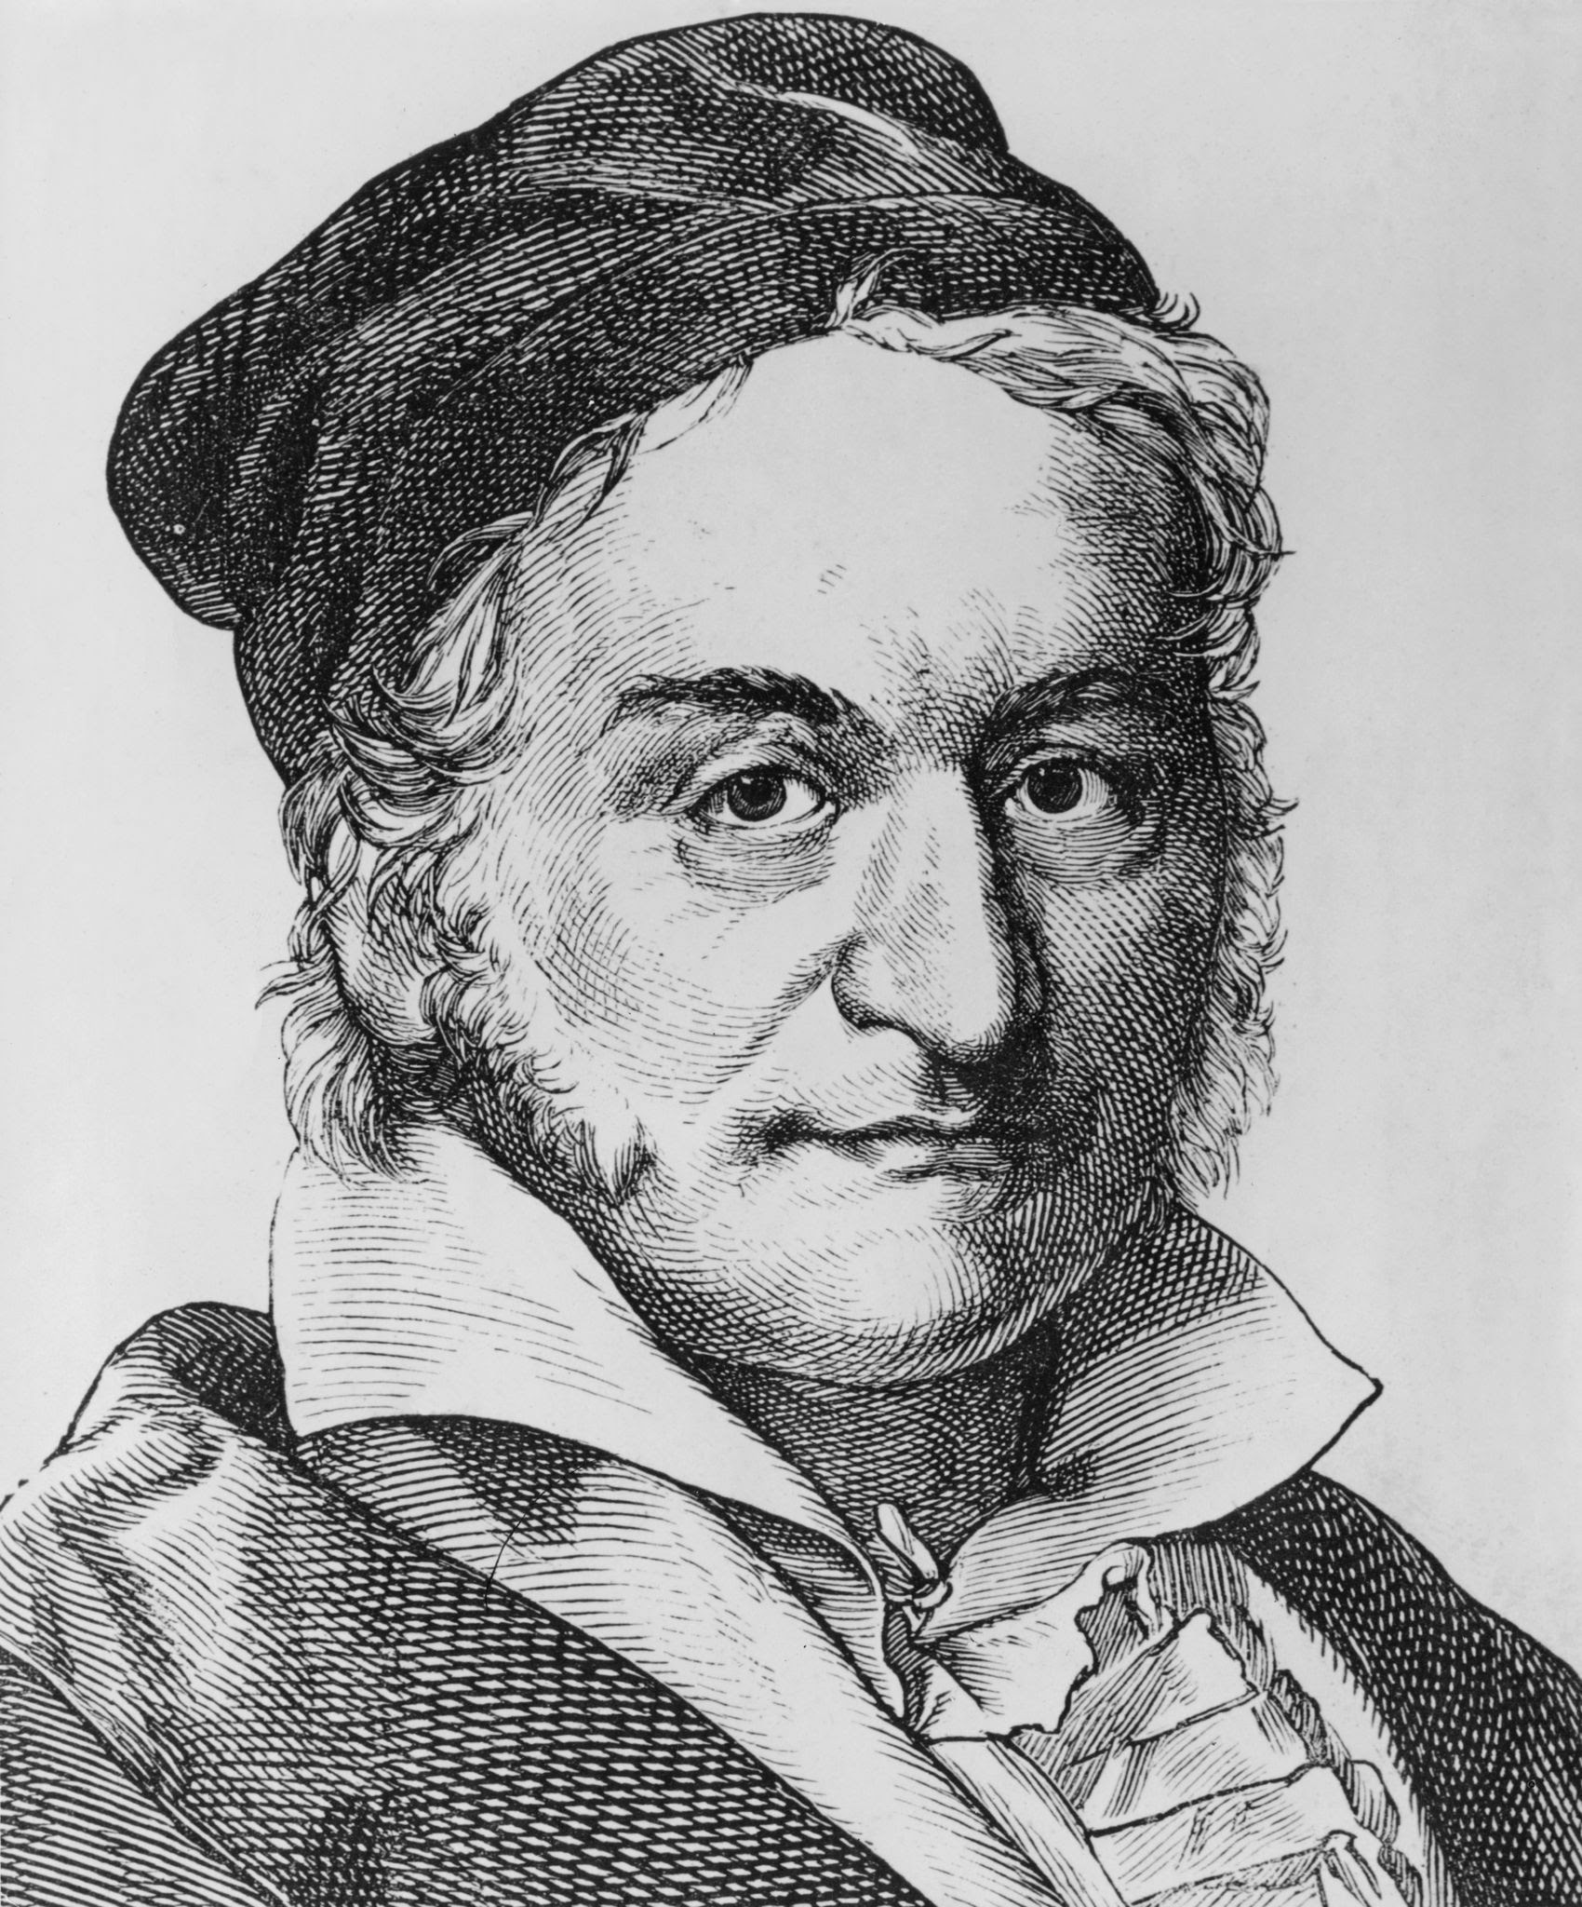
Probability Distributions: Normal
Normal Distribution. A continuous random variable $X$ is said to have a normal distribution if the density is given by
$$p_{X}\left(x;μ,σ^{2}\right)=\frac{1}{\sqrt{2π}σ}\exp\left(−\frac{{\left(x−μ\right)}^{2}}{2σ^{2}}\right)$$
Properties:
$$E\left[X\right]=μ$$
$$var\left[X\right]=σ^{2}$$
Importance. The Normal distribution plays a fundamental role in ML!
Data Modelling: The limit distribution for the sum of a large number of indepedent and identically distributed random variables.
Machine Learning: The most common prior distribution for the parameters of prediction functions!
Information Theory: The distribution function with the most uncertainty (“entropy”) when fixing mean and variance of the random variable.
Carl Friedrich Gauss (1777 - 1855)

Slide 8
Normal Distribution: Representations
Scale-Location Parameters
$$𝒩\left(x;μ,σ^{2}\right)=\frac{1}{\sqrt{2π}σ}⋅\exp\left(−\frac{{\left(x−μ\right)}^{2}}{2σ^{2}}\right)$$
Conversions
$$𝒩\left(x;μ,σ^{2}\right)=𝒢\left(x;\frac{μ}{σ^{2}},\frac{1}{σ^{2}}\right)$$
Posterior Inference
Natural Parameters
$$𝒢\left(x;τ,ρ\right)=\sqrt{\frac{ρ}{2π}}⋅\exp\left(−\frac{τ^{2}}{2ρ}\right)⋅\exp\left(τ⋅x−ρ⋅\frac{x^{2}}{2}\right)$$
Conversions
$$𝒢\left(x;τ,ρ\right)=𝒩\left(x;\frac{τ}{ρ},\frac{1}{ρ}\right)$$
Posterior Inference
Two divisions only!

Slide 9
Normal Distributions: Efficient Products & Divisions
Theorem (Multiplication). Given two one-dimensional Gaussian distributions $𝒢\left(x;τ_{1},ρ_{1}\right)$ and $𝒢\left(x;τ_{2},ρ_{2} \right)$ we have
$$𝒢\left(x;τ_{1},ρ_{1}\right)⋅𝒢\left(x;τ_{2},ρ_{2}\right)=𝒢\left(x;τ_{1}+τ_{2},ρ_{1}+ρ_{2}\right)⋅𝒩\left(μ_{1};μ_{2},σ_{1}^{2}+σ_{2}^{2}\right)$$
Theorem (Division). Given two one-dimensional Gaussian distributions $𝒢\left(x;τ_{1},ρ_{1}\right)$ and $𝒢\left(x;τ_{2},ρ_{2}\right)$ where $ρ_{1}≥ρ_{2}$ we have
$$\frac{𝒢\left(x;τ_{1},ρ_{1}\right)}{𝒢\left(x;τ_{2},ρ_{2}\right)}=\frac{𝒢\left(x;τ_{1}−τ_{2},ρ_{1}−ρ_{2}\right)}{𝒩\left(μ_{1};μ_{2},σ_{2}^{2}−σ_{1}^{2}\right)}⋅\frac{σ_{2}^{2}}{σ_{2}^{2}−σ_{1}^{2}}$$
Gaussian density
Additive updates!
Correction factor
Subtractive updates!
Gaussian density

Slide 10
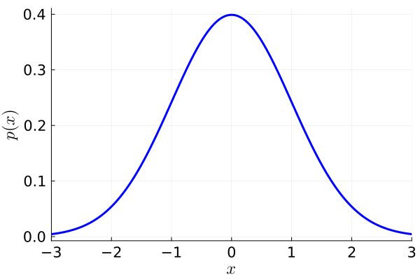
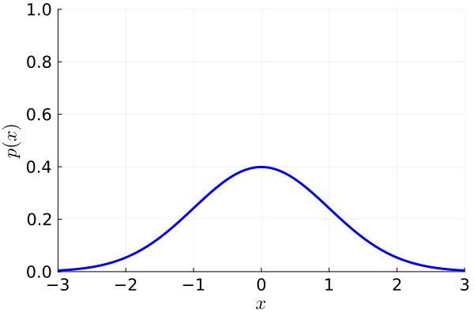
Limit Normal Distributions: Dirac Delta and Uniform
Dirac Delta. The Dirac delta function $δ\left(⋅\right)$ is defined as the limit $σ^{2}→0$
$$δ\left(x\right)=\lim_{σ^{2}→0}{𝒩\left(x;0,σ^{2}\right)}$$
Gaussian Uniform. The Gaussian uniform $𝒰\left(⋅\right)$ is defined as the limit $σ^{2}→∞$
$$𝒰\left(x\right)=\lim_{σ^{2}→+∞}{𝒩\left(x;0,σ^{2}\right)}$$
Theorem (Convolution of Normal with Dirac). For any $μ∈ℝ$ and $σ^{2}∈ℝ^{+}$
$$\int_{−∞}^{+∞}{δ\left(x\right)⋅𝒩\left(x;μ,σ^{2}\right)}dx=𝒩\left(0;μ,σ^{2}\right)$$
Theorem (Product of Normal with Uniform). For any $μ∈ℝ$ and $σ^{2}∈ℝ^{+}$
$$\frac{𝒰\left(x\right)⋅𝒩\left(x;μ,σ^{2}\right)}{\int_{−∞}^{+∞}{𝒰\left(\tilde{x}\right)⋅𝒩\left(\tilde{x};μ,σ^{2}\right)}d\tilde{x}}=𝒩\left(x;μ,σ^{2}\right)$$
Gaussian density at $x=0$
Equivalent to multiplying with 1

Slide 11
Overview
Bayesian Probabilities and Conjugacy
Graphical Models
The Sum-Product Algorithm
Bayesian Ranking: TrueSkill
Information Theory
Arithmetic Coding

Slide 12
Graphical Models
Challenge: How to formulate complex likelihoods/data models & priors for actual data?
Example 1: Match outcomes $y∈\left\{−1,1\right\}$ (data) for a head-to-head match between two players
Prior: $p\left(s\right)=𝒩\left(s_{1};μ_{1},σ_{1}^{2}\right)⋅𝒩\left(s_{2};μ_{2},σ_{2}^{2}\right)$
Likelihood: $p\left(y|s\right)=\int{𝒩\left(p_{1};s_{1},β^{2}\right)⋅𝒩\left(p_{2};s_{2},β^{2}\right)⋅𝕀\left(y\left(p_{1}−p_{2}\right)>0\right) dp_{1} dp_{2}}$
Example 2: Time series $y$ of temperatures
Prior: $p\left(w\right)=𝒩\left(w;μ,σ^{2}\right)$
Likelihood: $p\left(y|w,X\right)=\int{𝒩\left(z_{1}; w⋅x_{1},τ^{2}\right)⋅𝒩\left(y_{1};z_{1},β^{2}\right)⋅𝒩\left(z_{2};z_{1}+w⋅x_{2},τ^{2}\right)⋯ dz}$
skill belief
marginalization
Match outcome
Player performance
External state mapping parameter belief
marginalization
Dynamics model
Observed temperature model
Conditional hidden state model

Slide 13
Graphical Models
Observation: The product structure of the probabilities seems crucial
Idea: Define a graph where each of the variables are nodes and edges indicate factor relationships between variables
Advantages: Simple way to visualize factor structure of the joint probability
Bayesian Networks: Insights into (conditional) independence based on graph properties
Factor Graphs: Insights into efficient inference and approximation algorithms
$$𝒩\left(s_{1};μ_{1},σ_{1}^{2}\right)⋅𝒩\left(s_{2};μ_{2},σ_{2}^{2}\right)⋅𝒩\left(p_{1};s_{1},β^{2}\right)⋅𝒩\left(p_{2};s_{2},β^{2}\right)⋅𝕀\left(y\left(p_{1}−p_{2}\right)>0\right)$$
$$𝒩\left(w;μ,σ^{2}\right)⋅𝒩\left(z_{1}; w⋅x_{1},τ^{2}\right)⋅𝒩\left(y_{1};z_{1},β^{2}\right)⋅𝒩\left(z_{2};z_{1}+w⋅x_{2},τ^{2}\right)⋅𝒩\left(y_{2};z_{2},β^{2}\right)⋯$$
$$s_{1}$$
$$s_{2}$$
$$x_{1}$$
$$x_{2}$$
$$x_{3}$$
$$p_{1}$$
$$p_{2}$$
$$w$$
$$z_{1}$$
$$z_{2}$$
$$z_{3}$$
$$y$$
$$y_{1}$$
$$y_{2}$$
$$y_{3}$$

Slide 14
Bayesian Networks
Observation. Any joint distribution $p\left(x_{1},…,x_{n}\right)$ can be written as
$$p\left(x_{1},…,x_{n}\right)=\prod_{i=1}^{n}{p\left(x_{i}|x_{1},…,x_{i−1}\right)}$$
Bayesian Network. Given a joint distribution as a product of conditional distributions, $p\left(x_{1},…,x_{n}\right)=\prod_{i=1}^{n}{p\left(x_{i}|{parents}_{i}\right)}$, a Bayesian network is a graph with a node for every variable $x_{i}$, and a directed edge from every variable $x∈{parent}_{i}$ to $x_{i}$. If the variable is independent of all other variables, it has no incoming edges.
Examples: For 3 variables, we have these four generic Bayesian networks
$$x_{1}$$
$$x_{2}$$
$$x_{1}$$
$$x_{2}$$
$$x_{1}$$
$$x_{2}$$
$$x_{1}$$
$$x_{2}$$
$$x_{3}$$
$$x_{3}$$
$$x_{3}$$
$$x_{3}$$
$$p\left(x_{1},x_{2},x_{3}\right)=p\left(x_{1}\right)⋅p\left(x_{2}|x_{1}\right)⋅p\left(x_{3}|x_{1},x_{2}\right)$$
$$p\left(x_{1},x_{2},x_{3}\right)=p\left(x_{1}\right)⋅\prod_{i=2}^{3}{p\left(x_{i}|x_{1}\right)}$$
$$p\left(x_{1},x_{2},x_{3}\right)=p\left(x_{1}\right)⋅\prod_{i=2}^{3}{p\left(x_{i}|x_{i−1}\right)}$$
$$p\left(x_{1},x_{2},x_{3}\right)=p\left(x_{3}|x_{1},x_{2}\right)⋅\prod_{i=1}^{2}{p\left(x_{i}\right)}$$
full mesh
star
chain
sink

Slide 15
Bayesian Network Models
$$p\left(x_{1},x_{2},…,x_{n}\right)=p\left(x_{1}\right)⋅\prod_{i=2}^{n}{p\left(x_{i}|x_{1}\right)}$$
Plate. If a subset of variables has the same relation only differing in their index, we use a ”plate” to collapse them into a single graphical element.
Increase readability of models for large amounts of parameters and data
A Bayesian network must always be a directed acyclic graph because only those have a topological order corresponding to a variable order.
Observed Variables. If a subset of variables has been observed (“data”), the variable nodes are usually shaded (“clamped”).
Example: Discriminatory Models
$$x_{1}$$
$$i=2,…,n$$
$$x_{i}$$
$$p\left(w,\left(x_{1},y_{1}\right),…,\left(x_{n},y_{n}\right)\right)=\prod_{i=1}^{n}{p\left(y_{i}|x_{i},w\right)}⋅p\left(w\right)$$
$$w$$
$$i=1,…,n$$
$x_{i}$
$$y_{i}$$
$$p\left(w|\left(x_{1},y_{1}\right),…,\left(x_{n},y_{n}\right)\right)∝\prod_{i=1}^{n}{p\left(y_{i}|x_{i},w\right)}⋅p\left(w\right)$$

Slide 16
Sampling a Bayesian Network
One advantage of a Bayesian network is the ability to sample $p\left(x_{1},…,x_{n}\right)$
Assumption
Sampling from the conditional distributions is simpler than from the joint distribution
There are no clamped nodes, that is, we do not condition on any variable
Problems
Sampling is sequential one variable at the time
Conditioning happens only on frequent events because for samples $x_{j,1},…,x_{j,n}$
Ancestral Sampling
Topologically sort all variables $x_{1},…,x_{n}$ into $x_{\left(1\right)},…,x_{\left(n\right)}$
Sample each variable $x_{\left(i\right)}$ using distribution $p\left(x_{\left(i\right)}|x_{\left(1\right)},…,x_{\left(i−1\right)}\right)$
$$\frac{\left|\left\{\left(x_{j,1},…,x_{j,n}\right) | x_{j,1}=x_{1}∧…∧x_{j,n}=x_{n}\right\}\right|}{\left|\left\{x_{j,n}=x_{n}\right\}\right|}$$
$$≈\frac{p\left(x_{1},…,x_{n}\right)}{p\left(x_{n}\right)}=p\left(x_{1},…,x_{n−1} | x_{n}\right)$$
$≈0$ for rare events

Slide 17
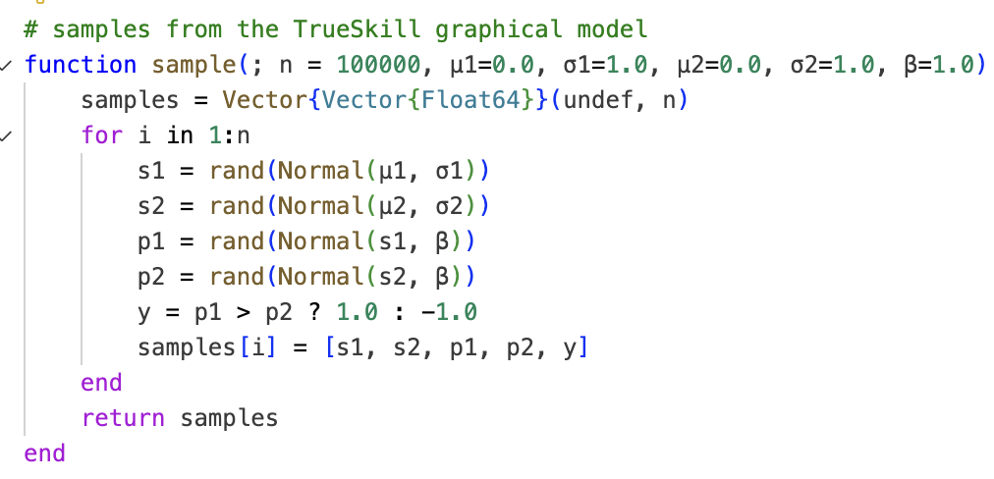
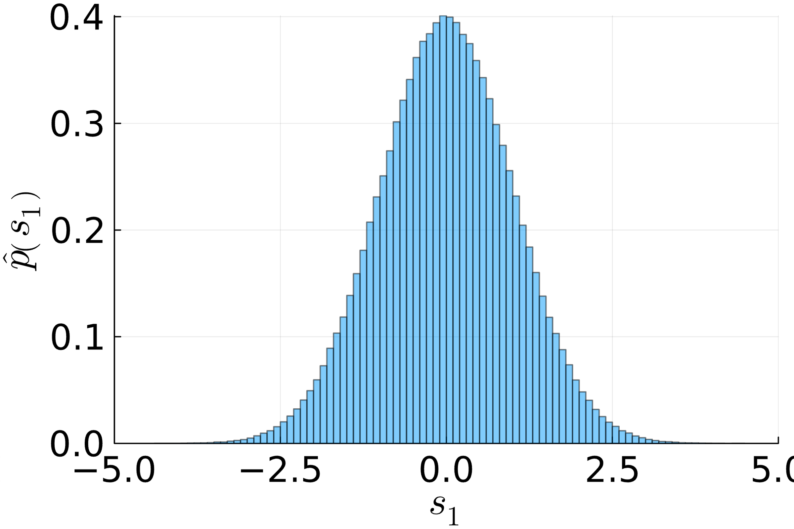

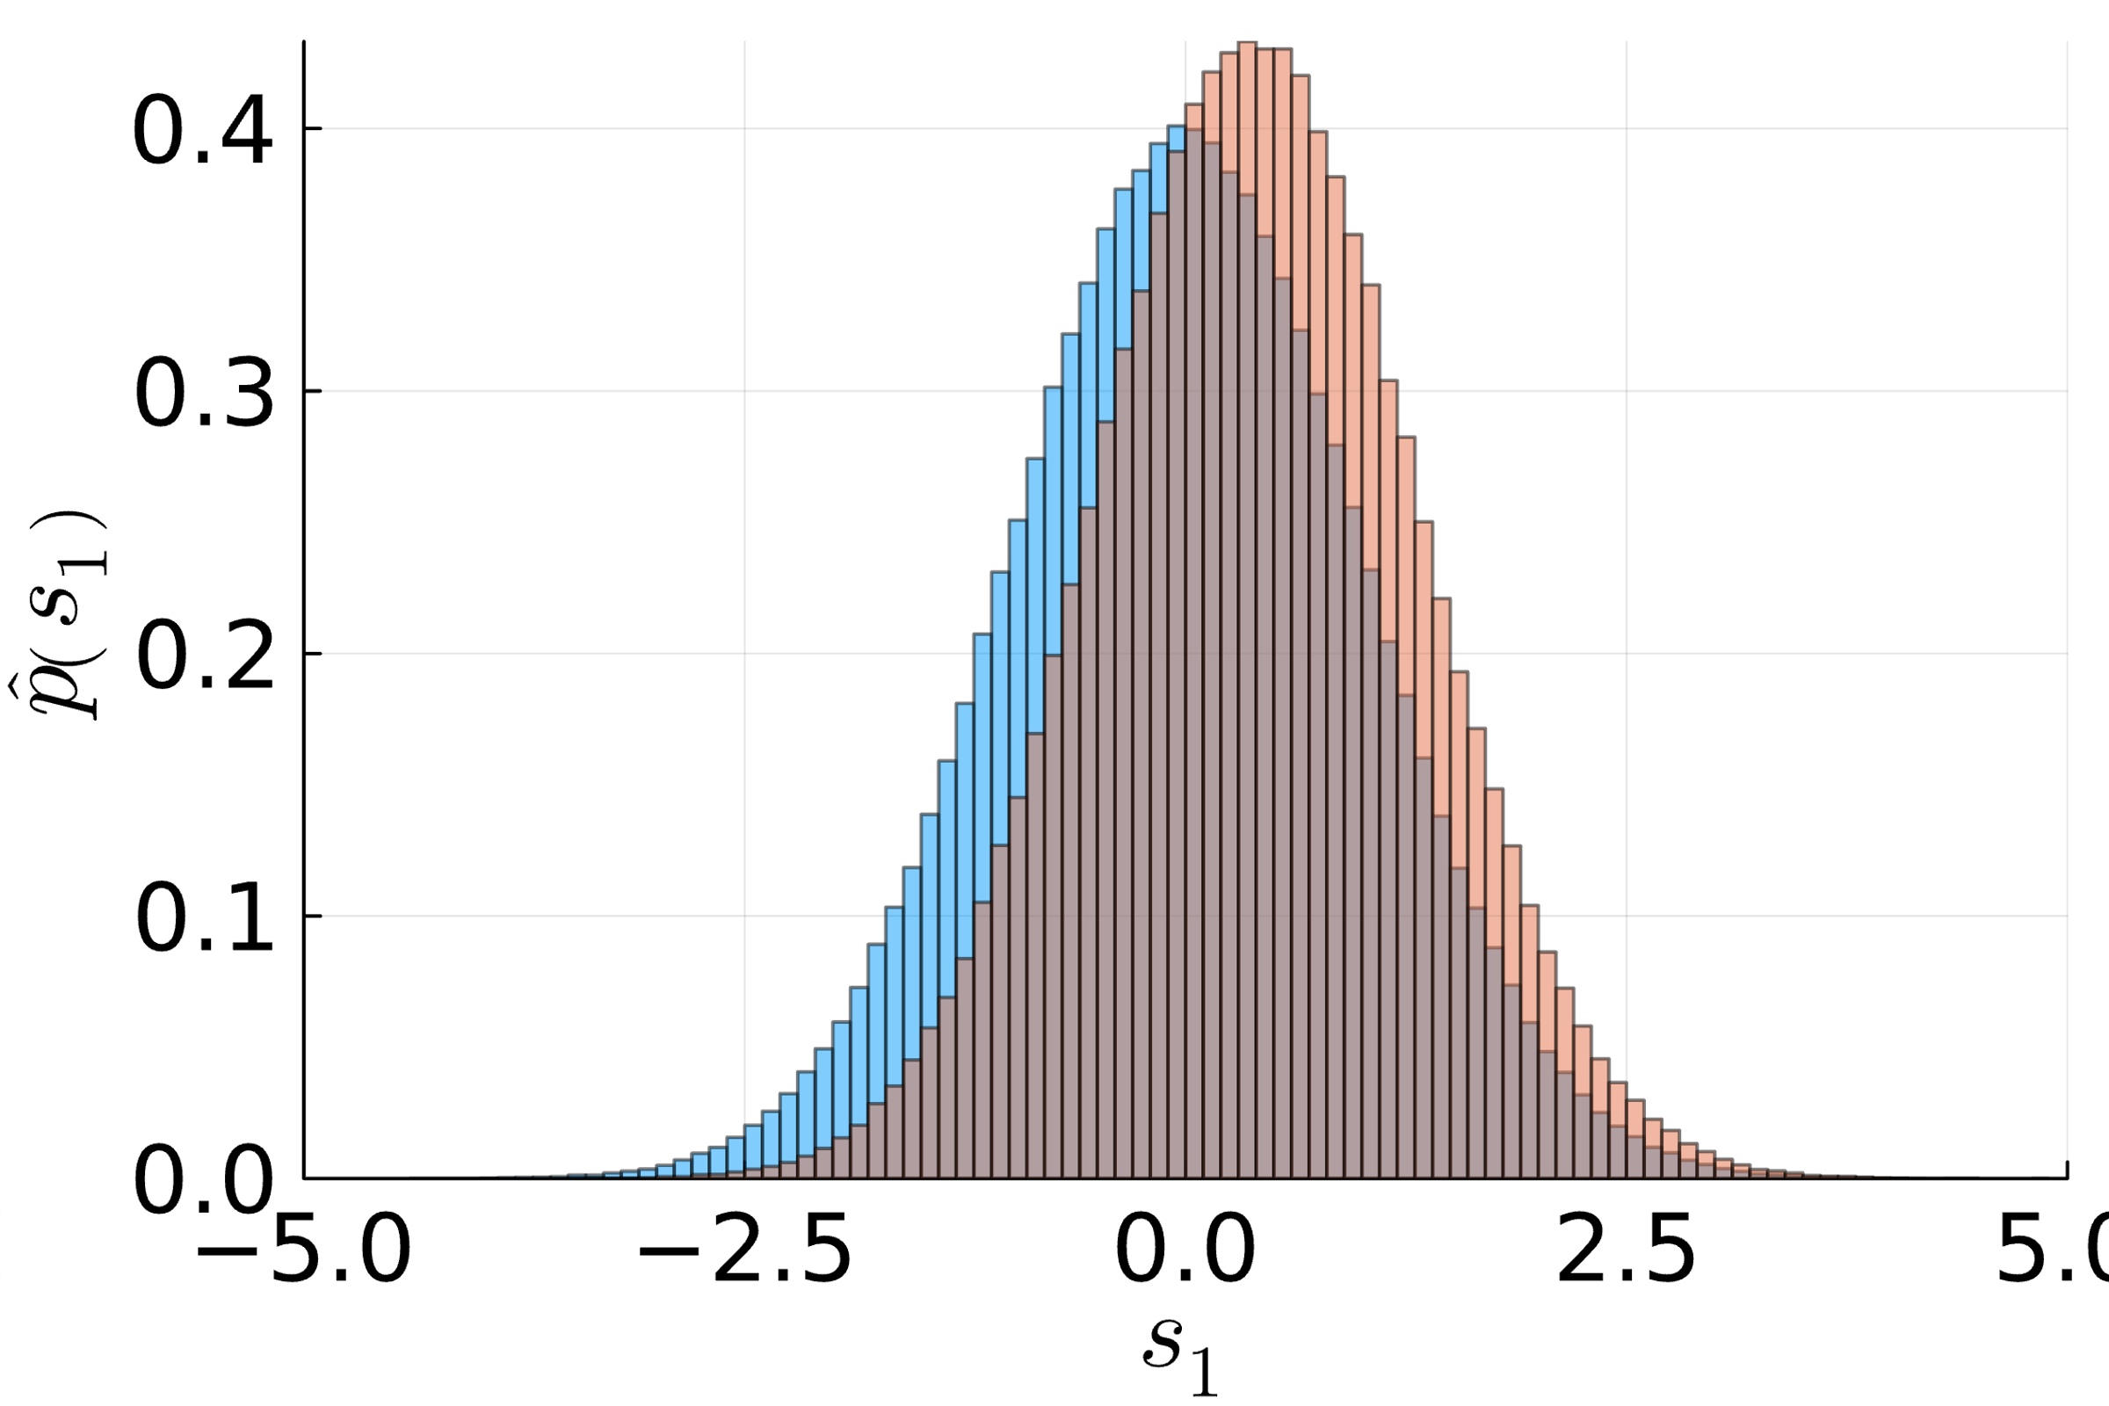
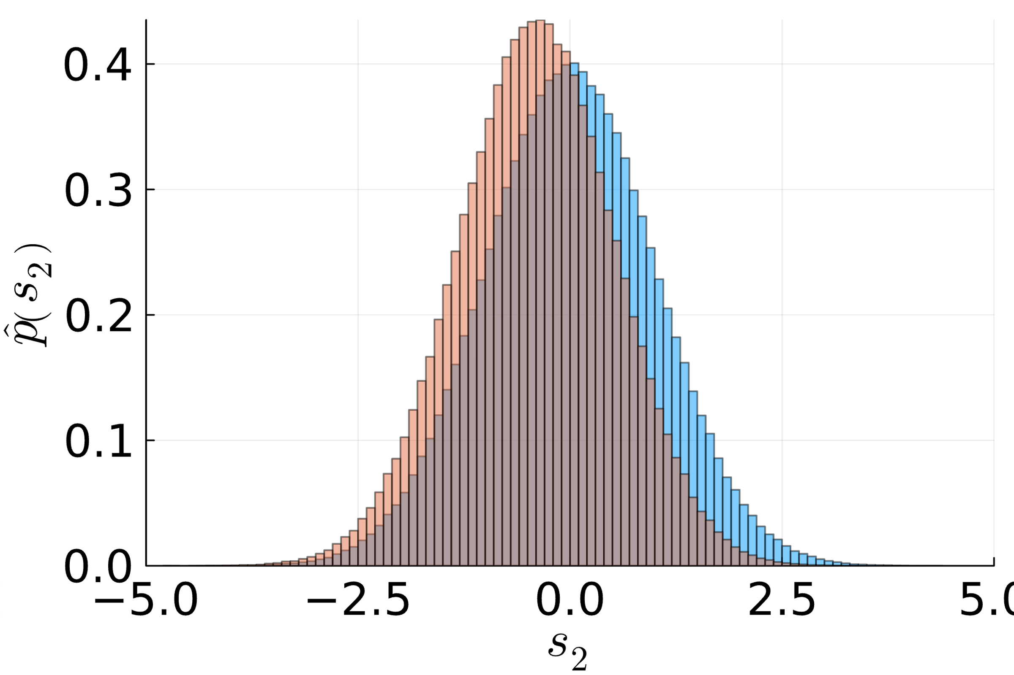
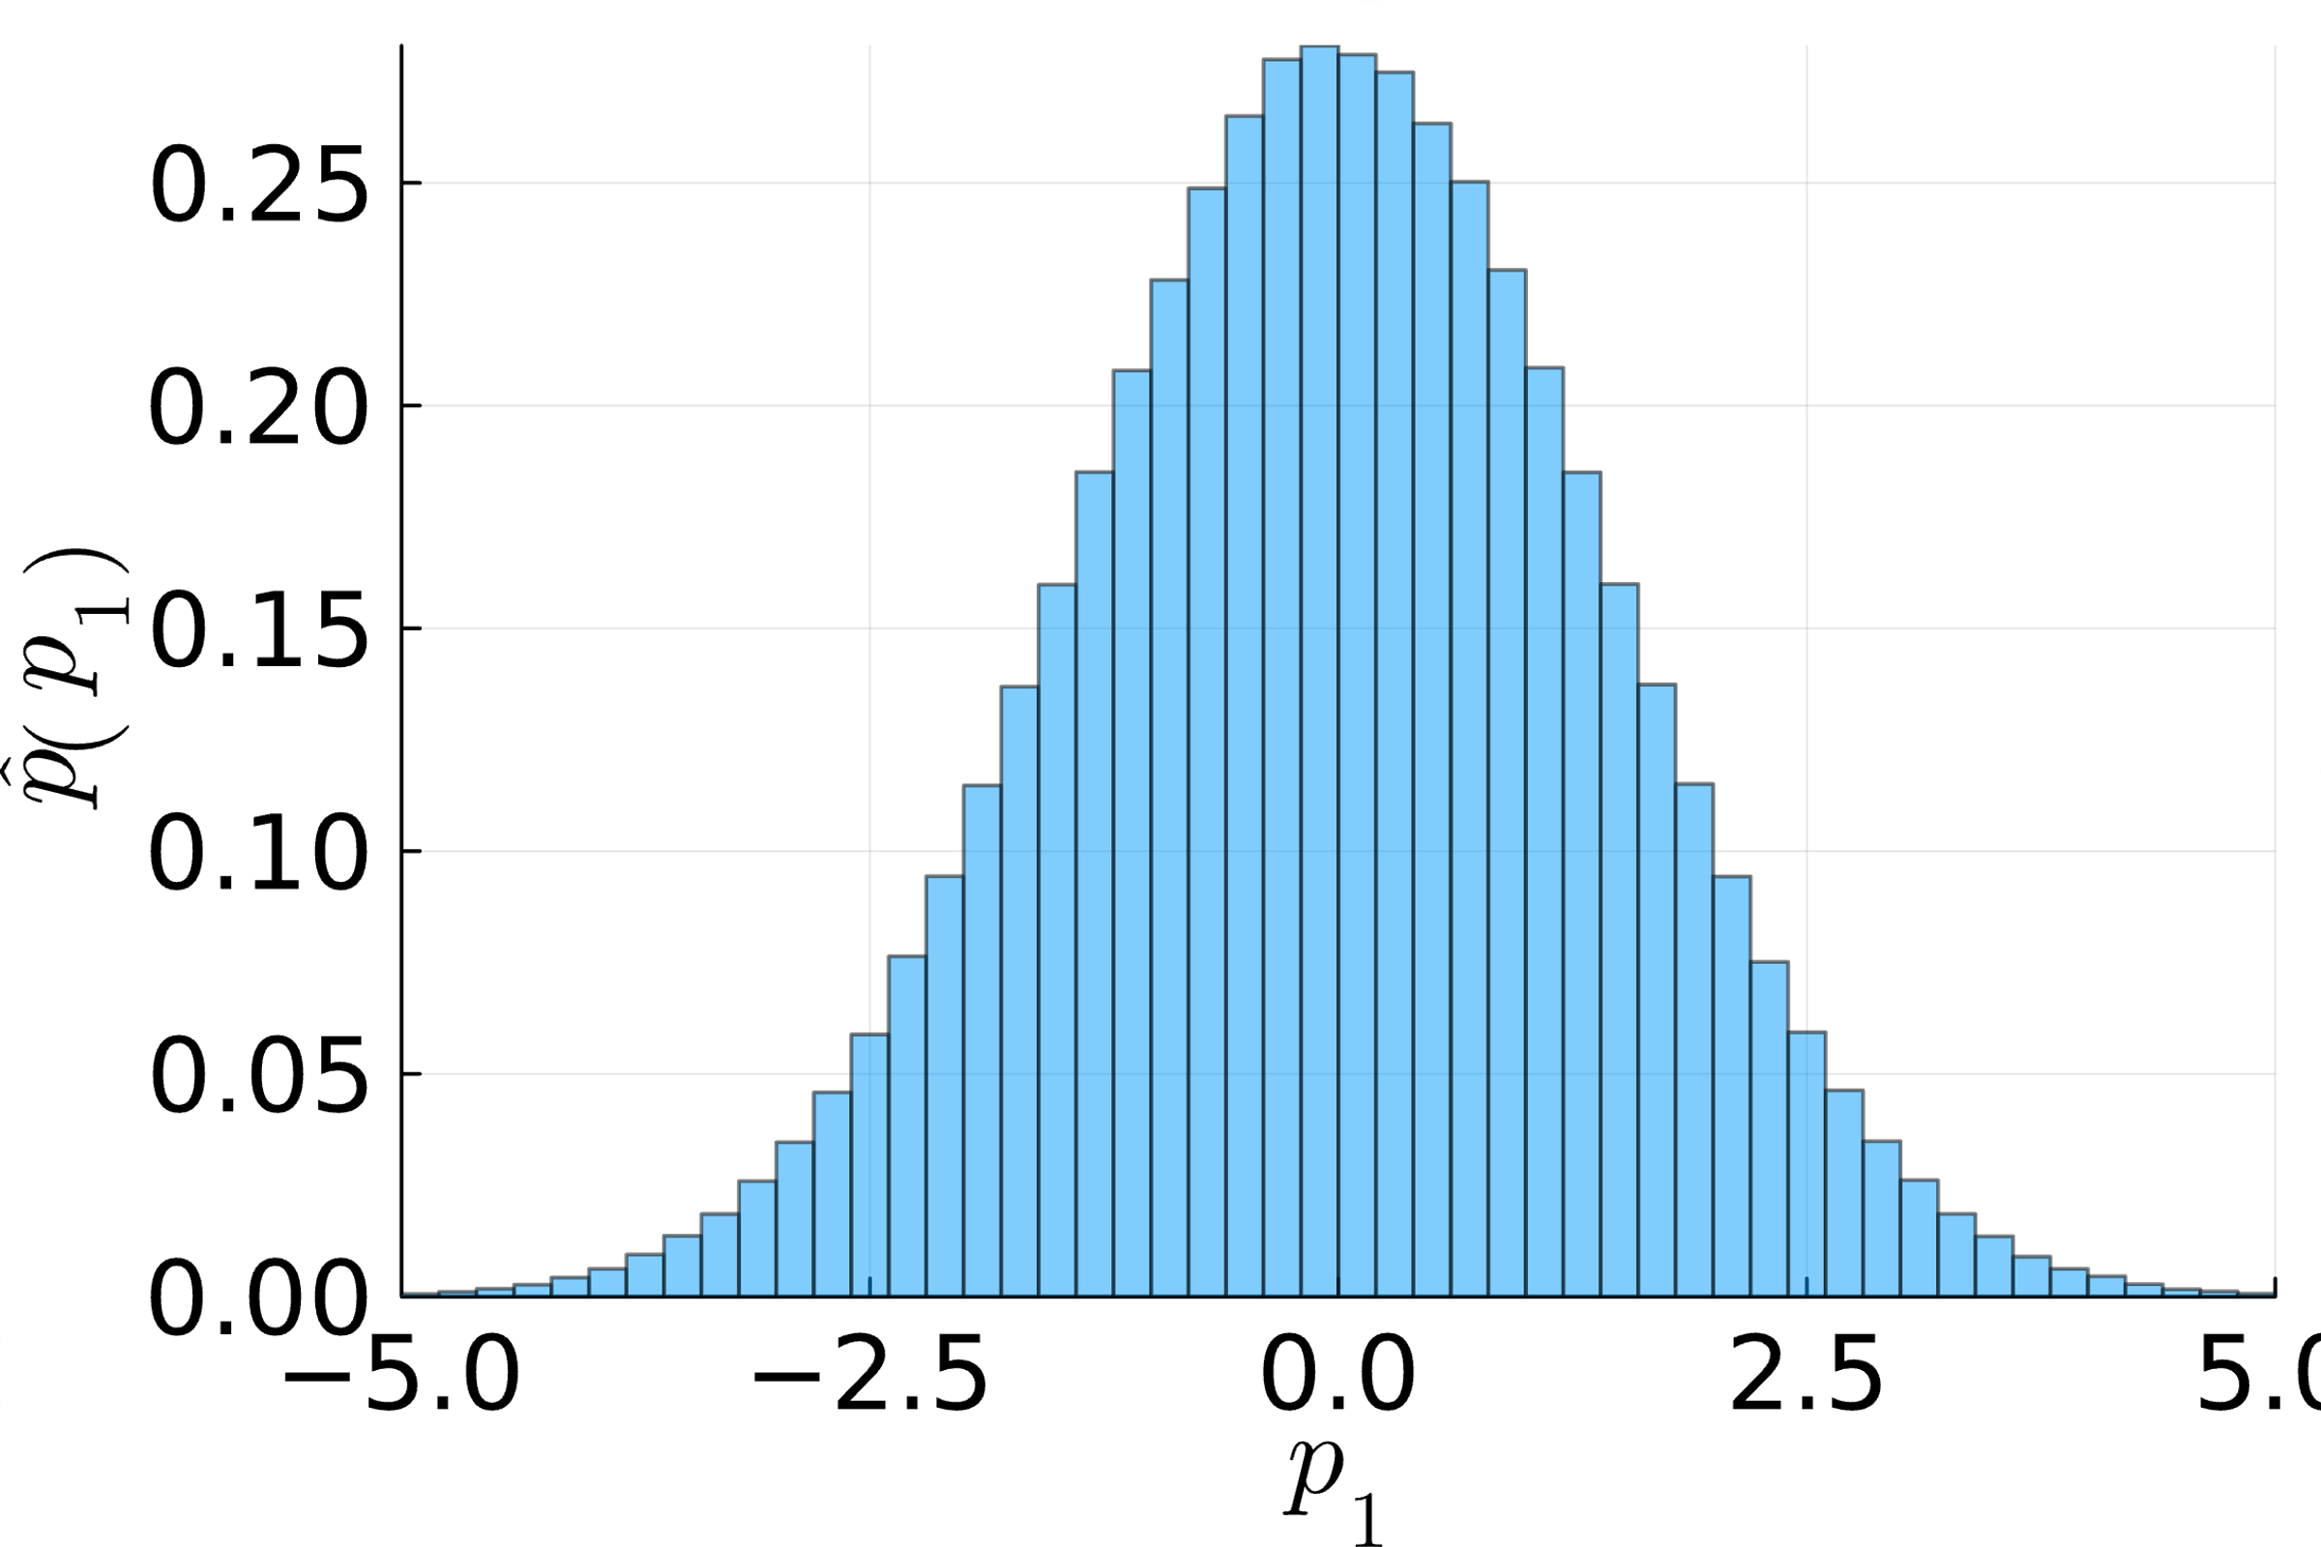

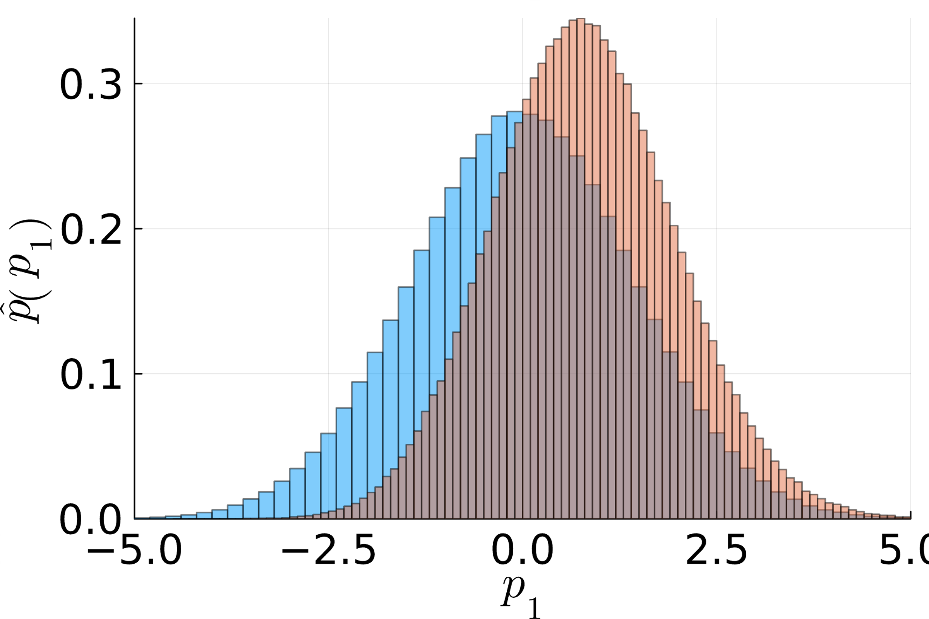
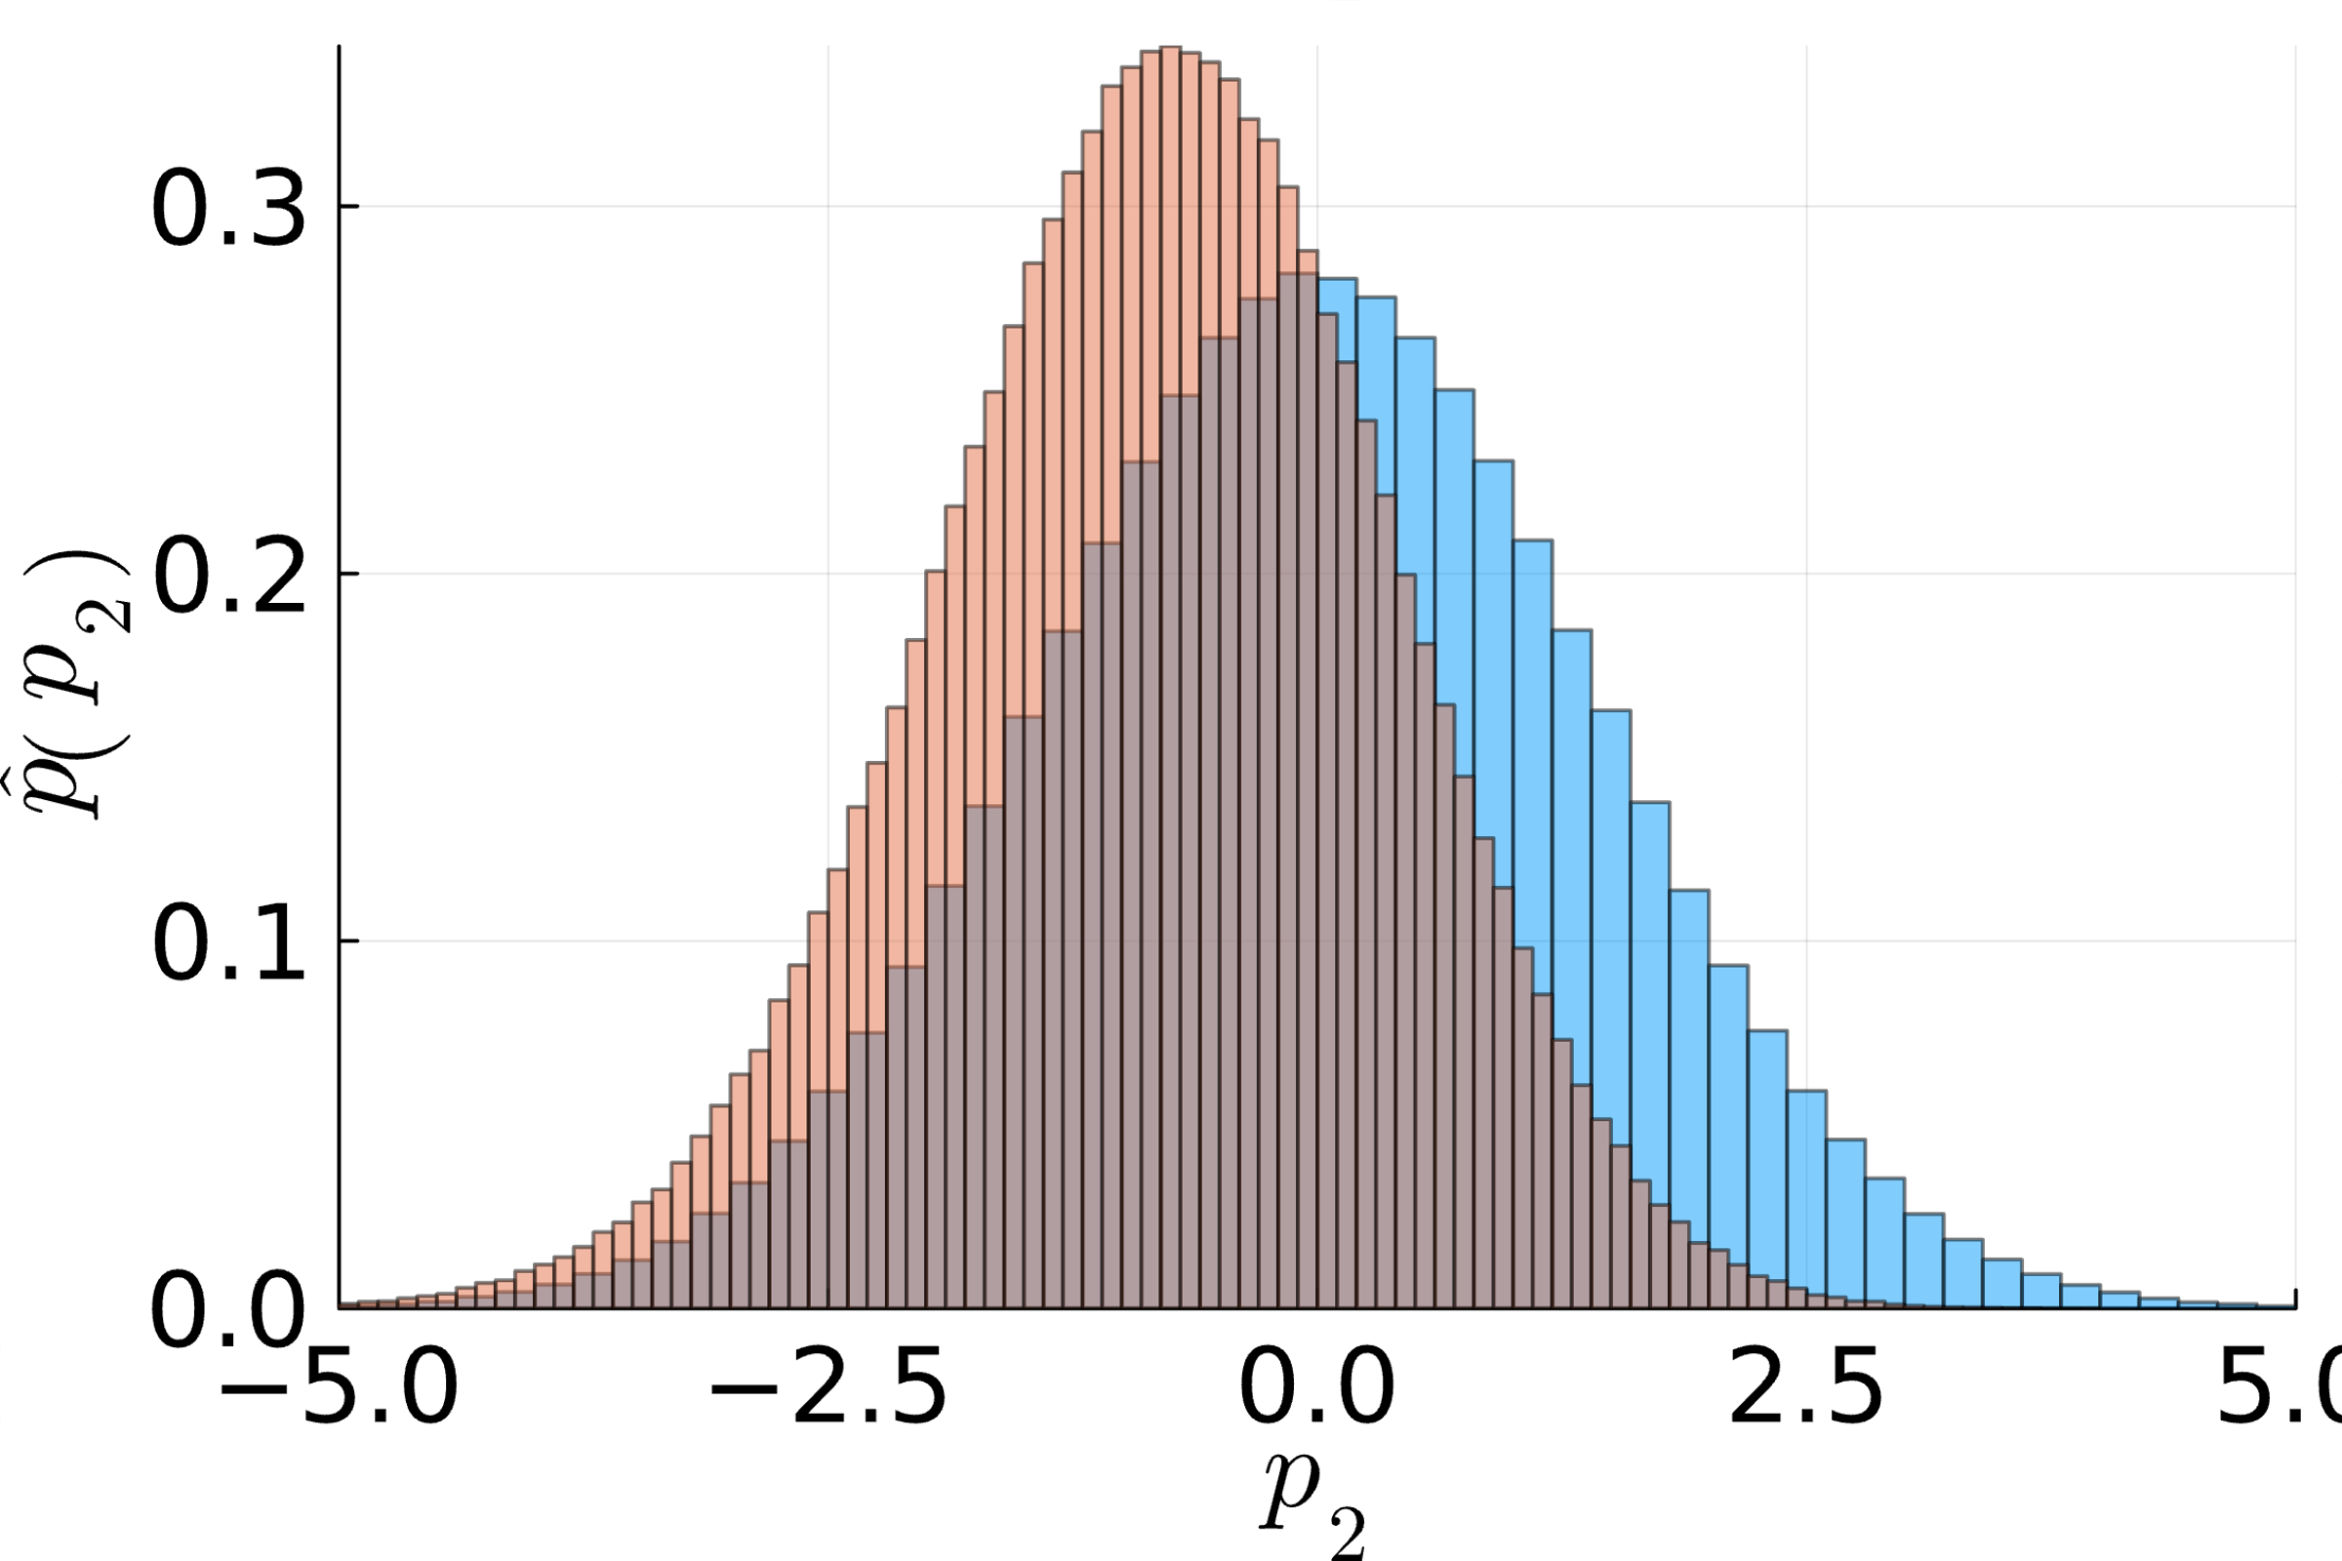
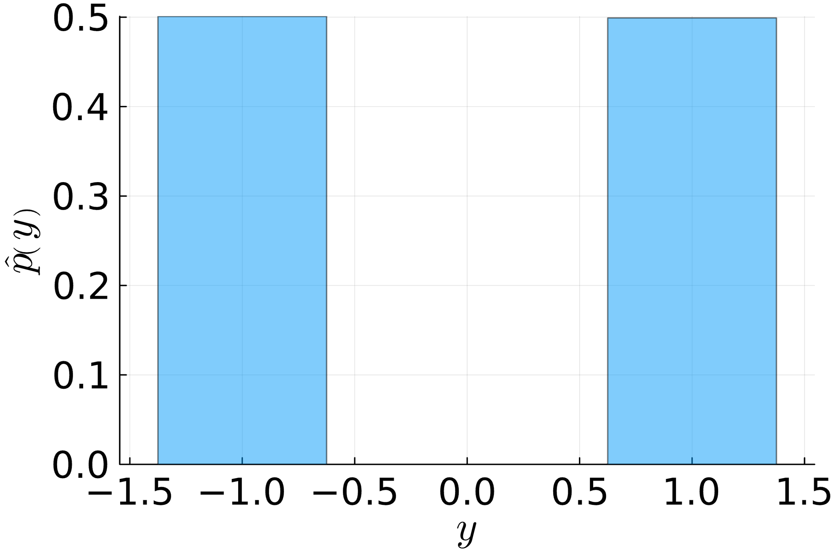
Sampling a Bayesian Network: Example
$$𝒩\left(s_{1};μ_{1},σ_{1}^{2}\right)⋅𝒩\left(s_{2};μ_{2},σ_{2}^{2}\right)⋅𝒩\left(p_{1};s_{1},β^{2}\right)⋅𝒩\left(p_{2};s_{2},β^{2}\right)⋅𝕀\left(y\left(p_{1}−p_{2}\right)>0\right)$$
$$μ_{1}=μ_{2}$$
Without match outcome
With match outcome ($y=1$)
$$s_{1}$$
$$s_{2}$$
$$s_{1}$$
$$s_{2}$$
$$p_{1}$$
$$p_{2}$$
$$p_{1}$$
$$p_{2}$$
$$y$$
$$y$$

Slide 18
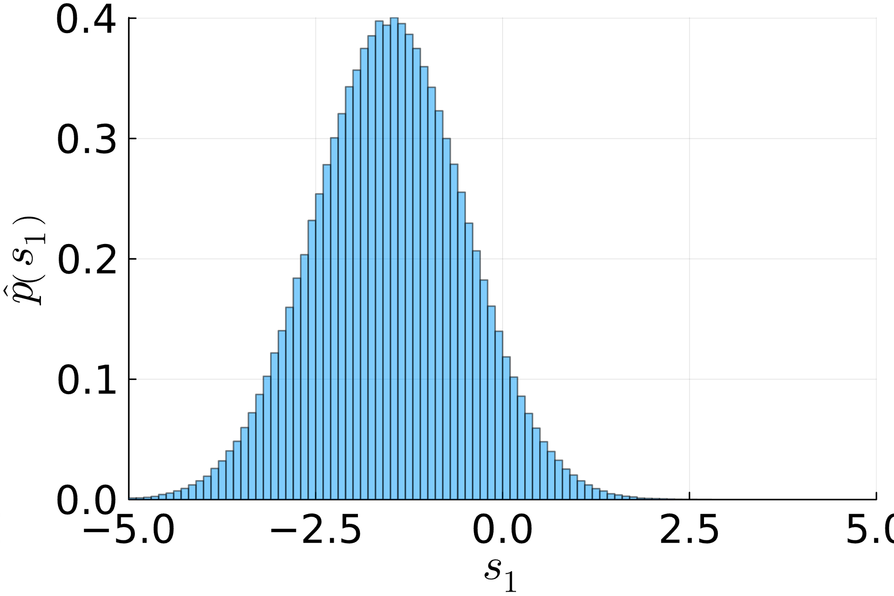
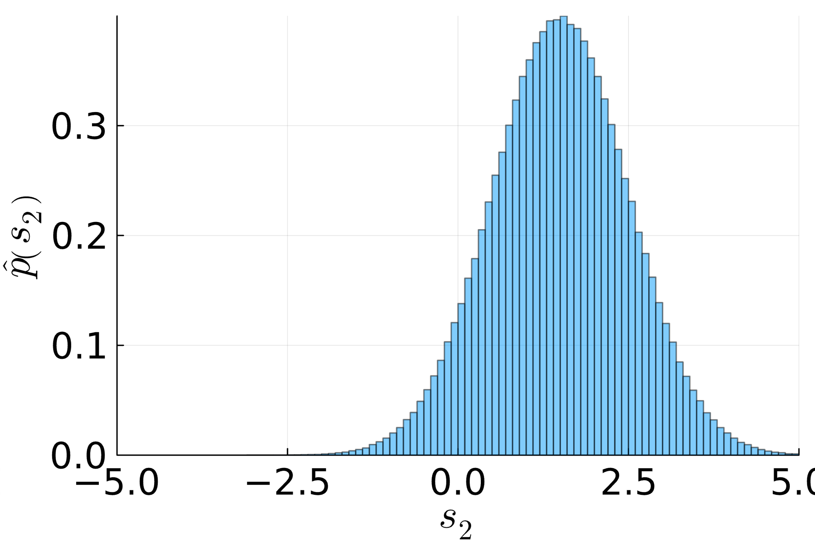
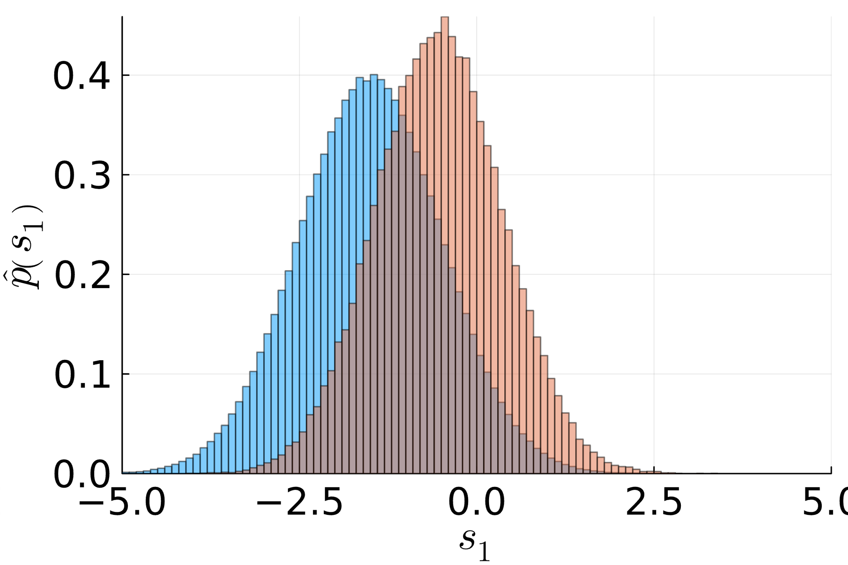
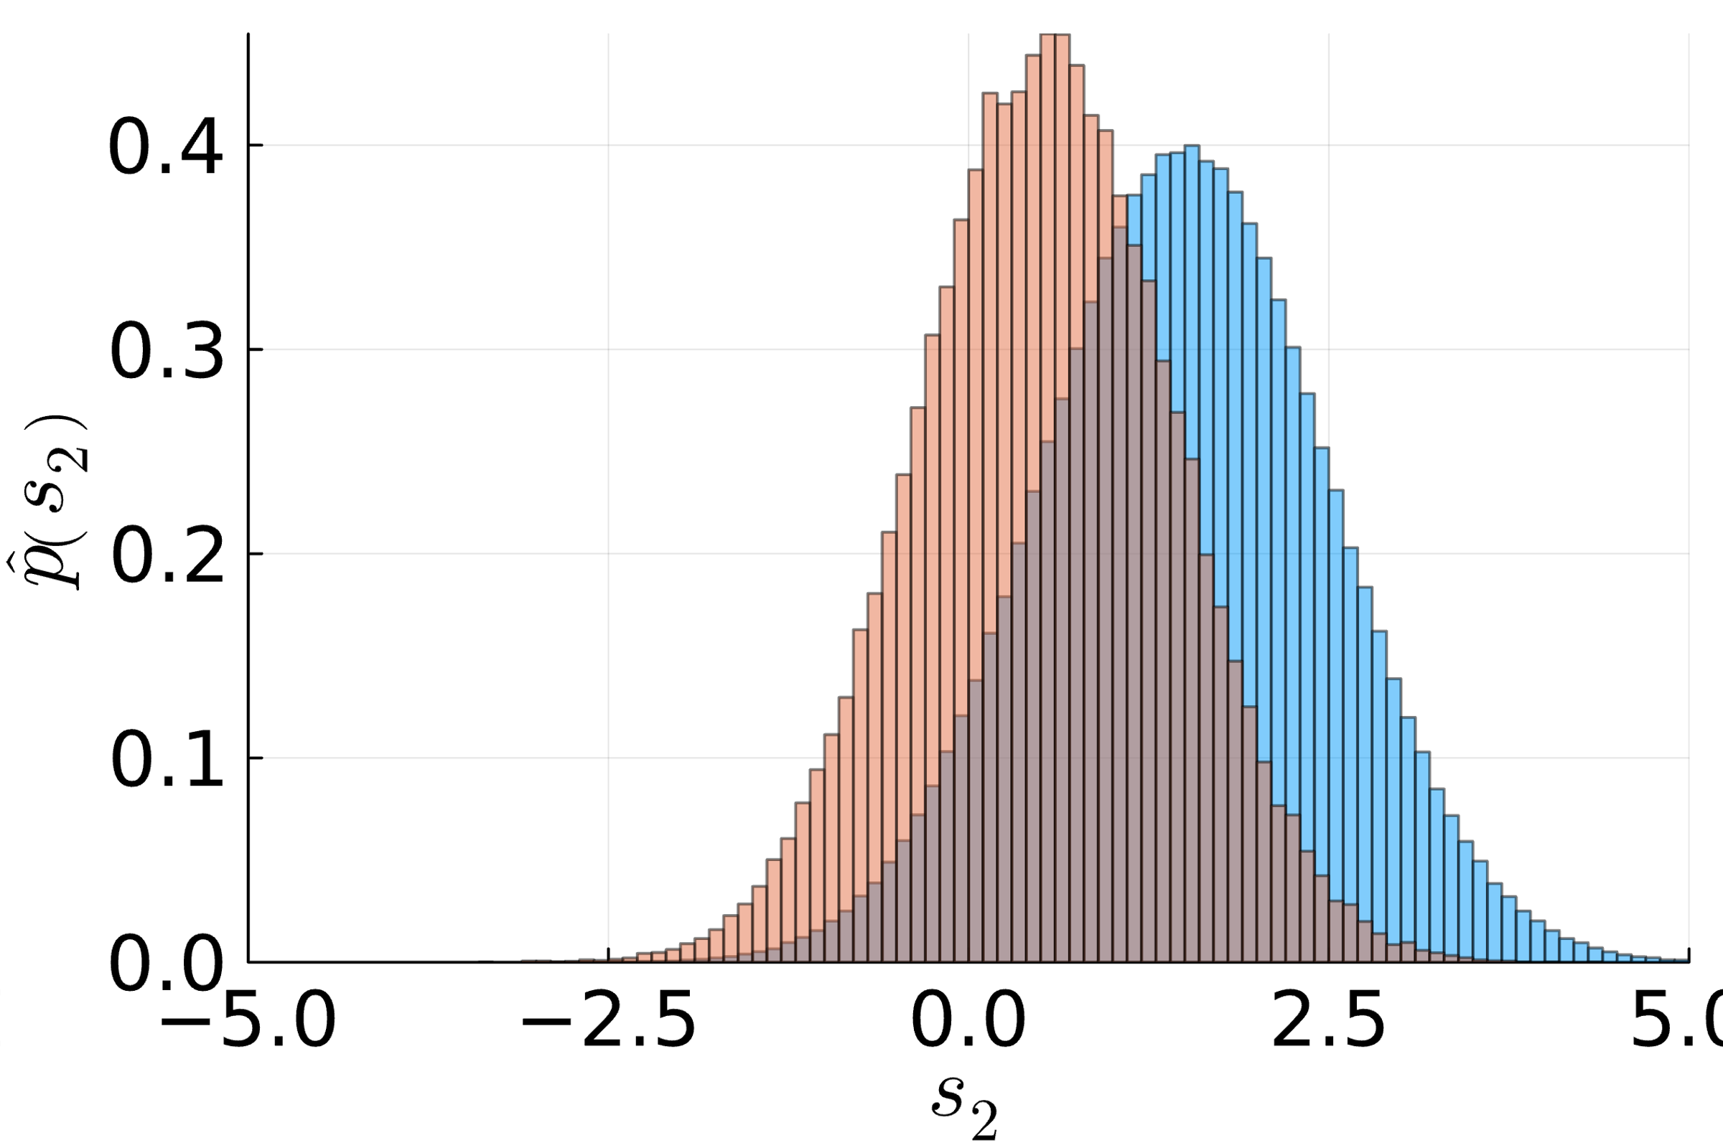
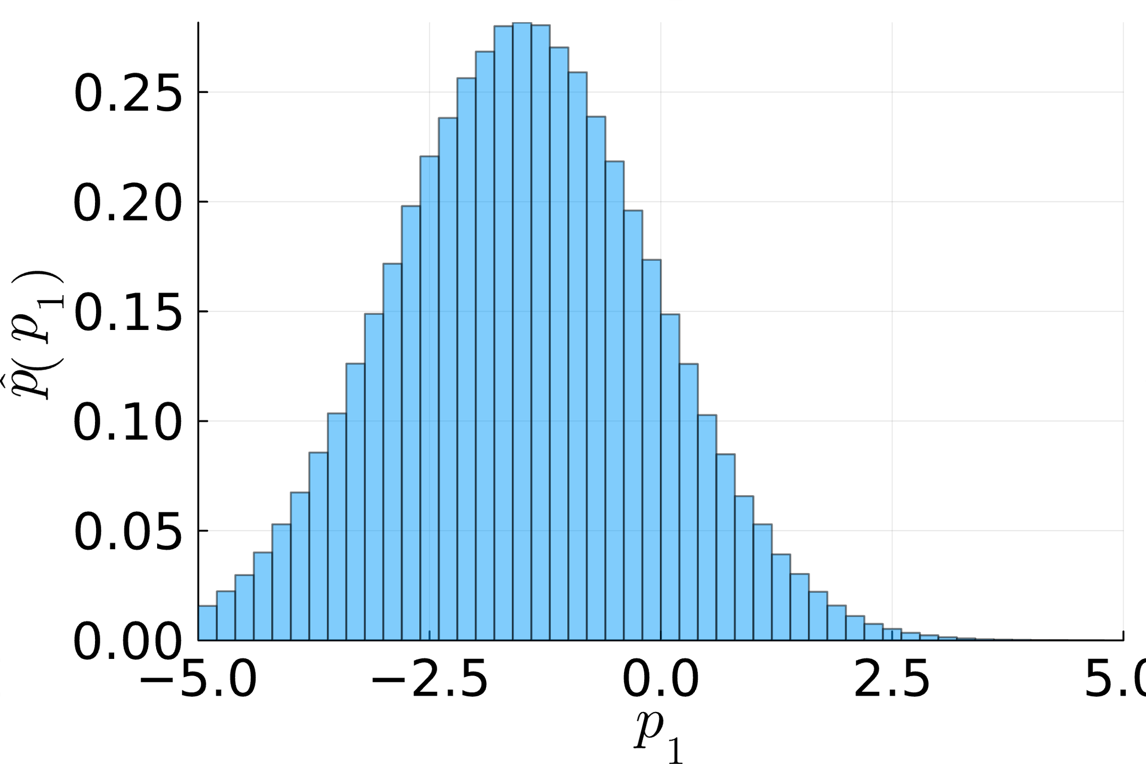
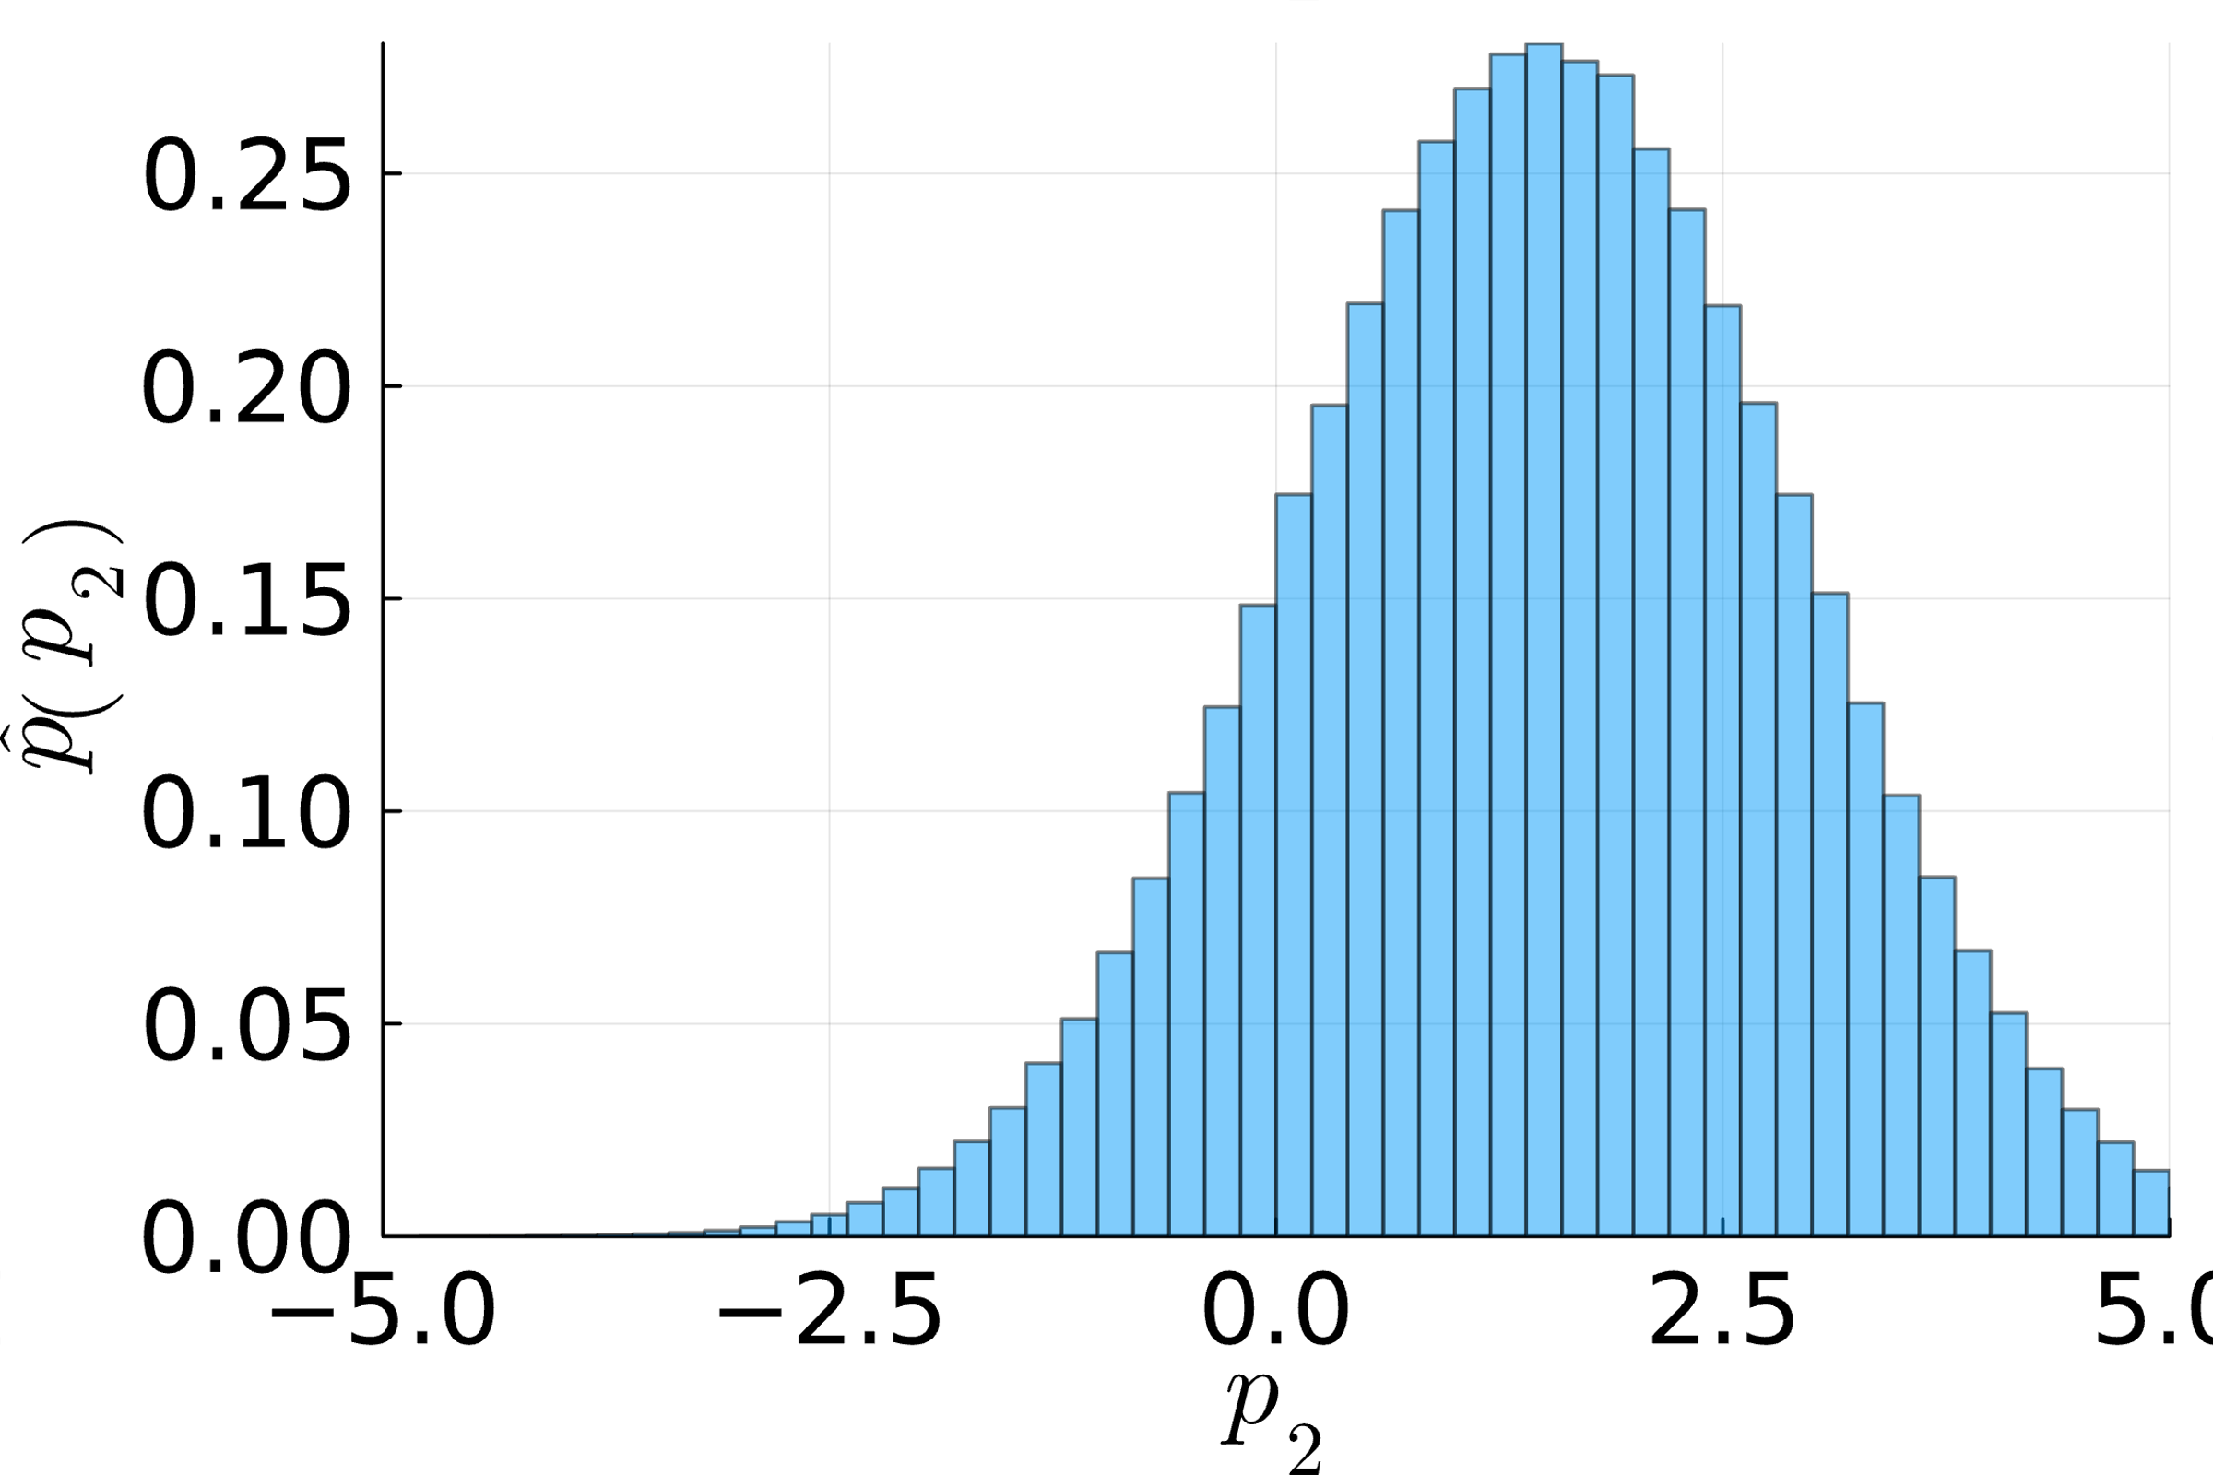
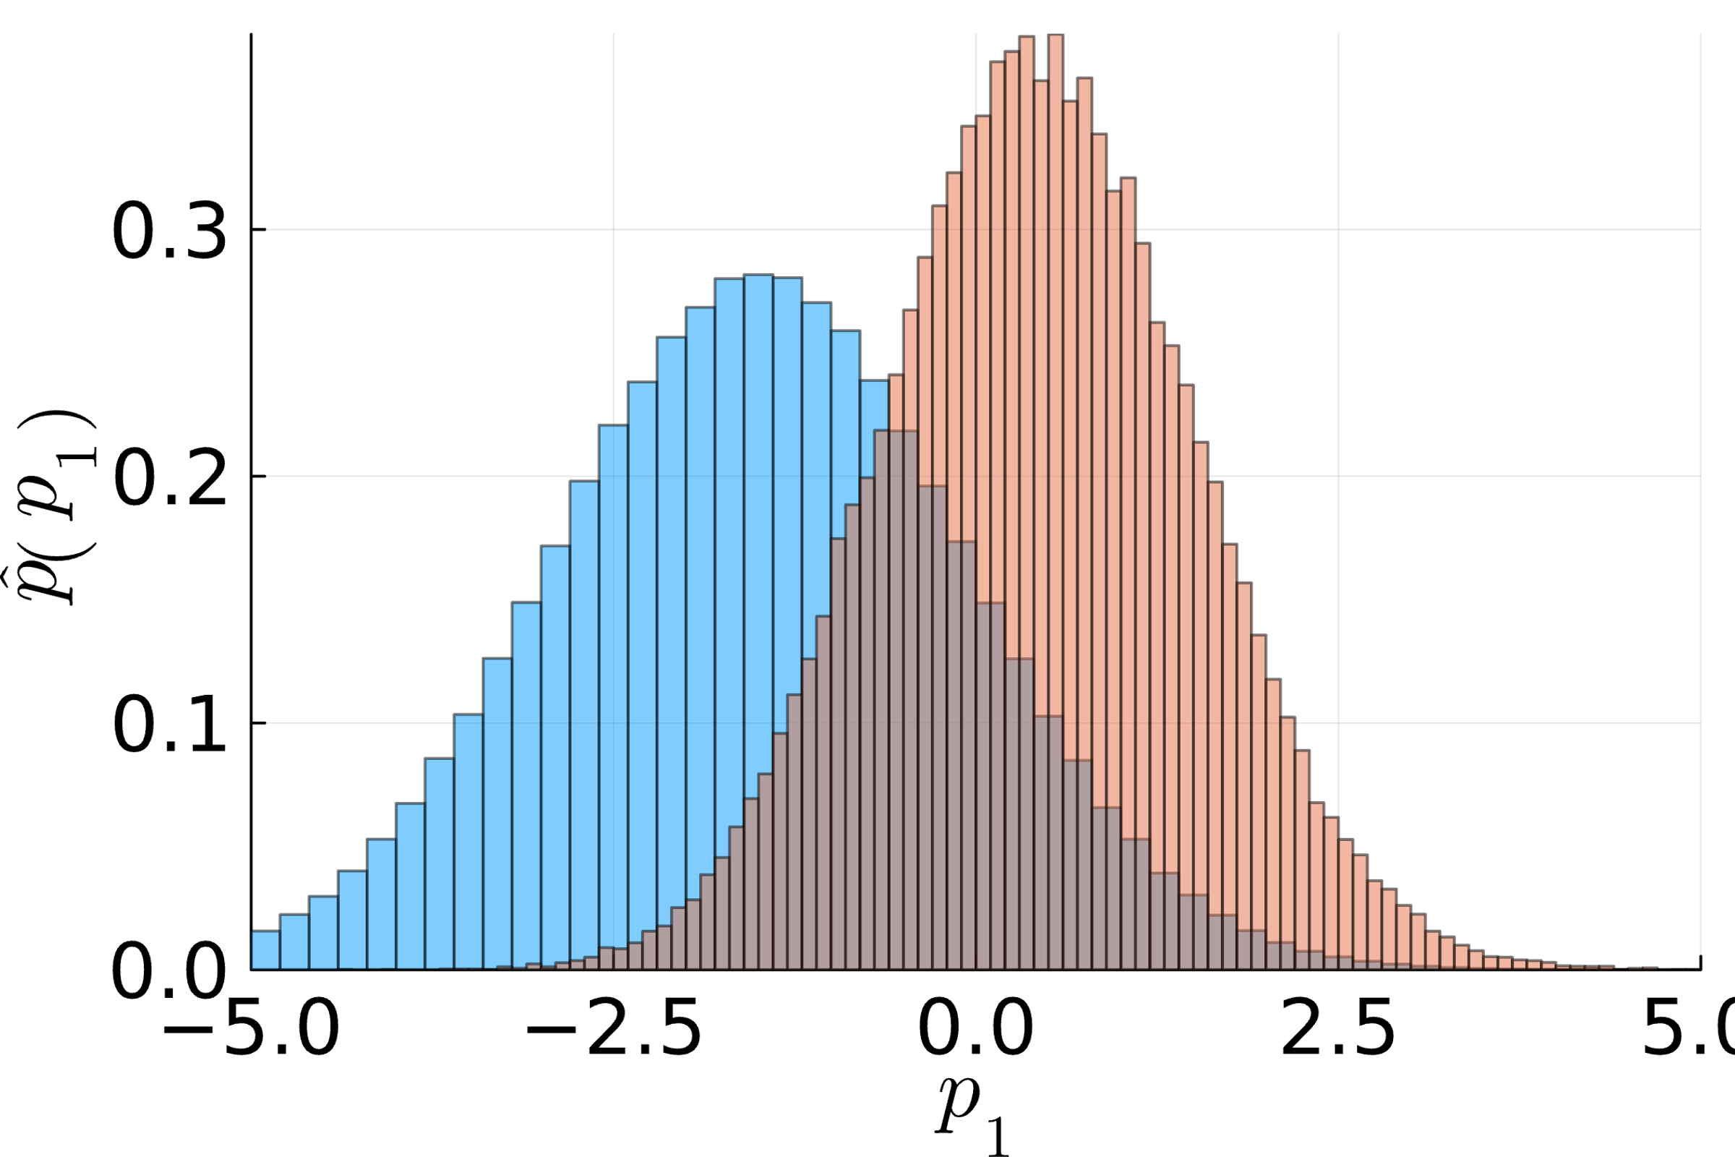
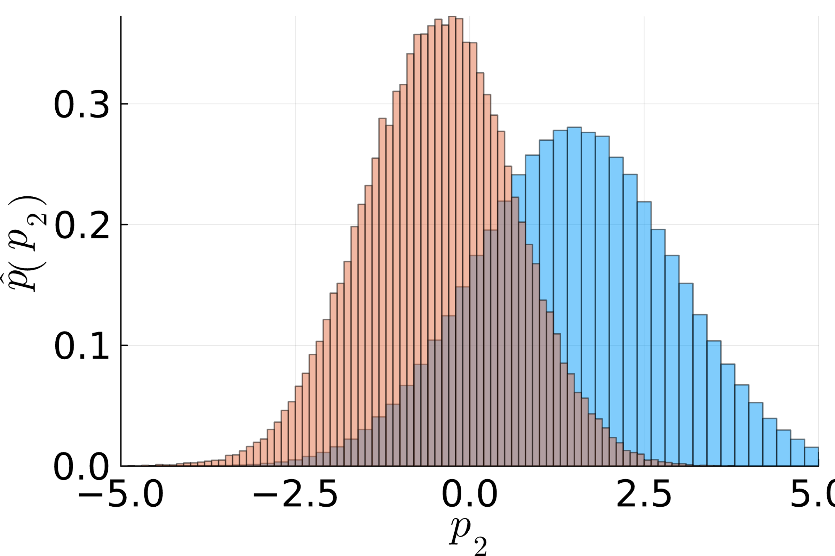
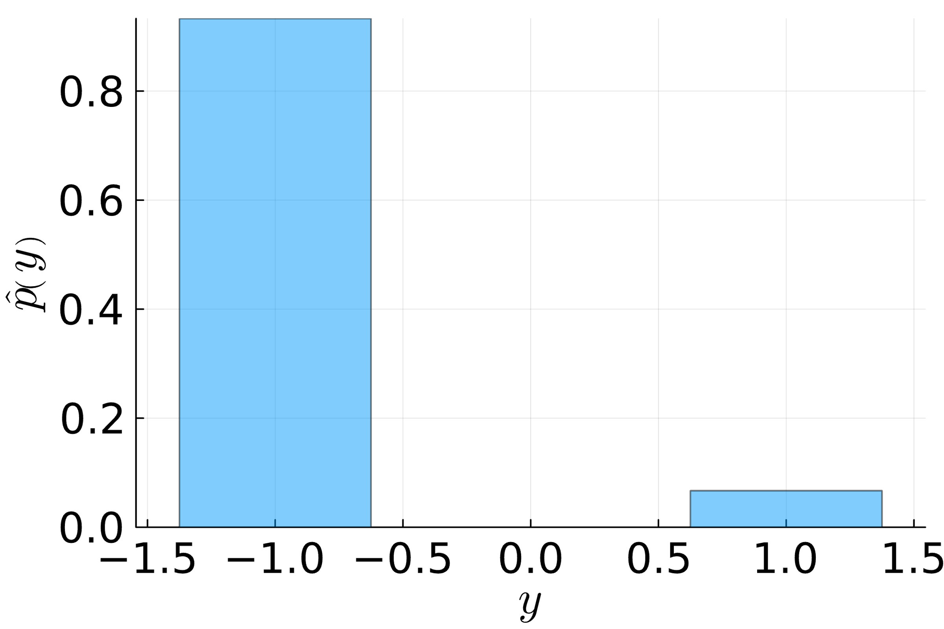
Sampling a Bayesian Network: Example (ctd)
$$𝒩\left(s_{1};μ_{1},σ_{1}^{2}\right)⋅𝒩\left(s_{2};μ_{2},σ_{2}^{2}\right)⋅𝒩\left(p_{1};s_{1},β^{2}\right)⋅𝒩\left(p_{2};s_{2},β^{2}\right)⋅𝕀\left(y\left(p_{1}−p_{2}\right)>0\right)$$
$$μ_{1}≪μ_{2}$$
Without match outcome
With match outcome ($y=1$)
$$s_{1}$$
$$s_{2}$$
$$s_{1}$$
$$s_{2}$$
$$p_{1}$$
$$p_{2}$$
$$p_{1}$$
$$p_{2}$$
$$y$$
$$y$$

Slide 19
Overview
Bayesian Probabilities and Conjugacy
Graphical Models
The Sum-Product Algorithm
Bayesian Ranking: TrueSkill
Information Theory
Arithmetic Coding

Slide 20
Inference in Probabilistic Models
Inference: In order to learn from data we follow a three-step procedure
Modelling: Formulate a joint model $p\left(θ,D\right)$ of parameters $θ=θ_{1},…,θ_{n}$ and data $D$
Conditioning: Clamp the variables that represent data $D$ (as they are observed)
Marginalize: Sum-out all variables that we are not interested in (latent parameters)
Example: Two player game with one winner
Modelling: Parameters $θ=\left(s_{1},s_{2},p_{1},p_{2}\right)$ are skills and performances; data is $y∈\left\{0,1\right\}$
Conditioning: Player 1 wins ($y=1$)
Marginalize: We are only interested in the skills and need to sum-out $p_{1}$ and $p_{2}$
$$s_{1}$$
$$s_{2}$$
$$p_{1}$$
$$p_{2}$$
$$y$$
$$p\left(s_{1},s_{2},p_{1},p_{2},y\right)=$$
$$\underset{\begin{matrix} \\ p\left(s_{1},s_{2}\right)\end{matrix}}{\underbrace{𝒩\left(s_{1};μ_{1},σ_{1}^{2}\right)⋅𝒩\left(s_{2};μ_{2},σ_{2}^{2}\right)}}$$
$$⋅𝒩\left(p_{1};s_{1},β^{2}\right)⋅𝒩\left(p_{2};s_{2},β^{2}\right)$$
$$⋅𝕀\left(y\left(p_{1}−p_{2}\right)>0\right)$$
$$p\left(s_{1},s_{2},p_{1},p_{2}|y=1\right)∝p\left(s_{1},s_{2}\right)⋅𝒩\left(p_{1};s_{1},β^{2}\right)⋅𝒩\left(p_{2};s_{2},β^{2}\right)⋅𝕀\left(p_{1}−p_{2}>0\right)$$
$$p\left(s_{1},s_{2}|y=1\right)∝p\left(s_{1},s_{2}\right)⋅\int_{−∞}^{+∞}{\int_{−∞}^{+∞}{𝒩\left(p_{1};s_{1},β^{2}\right)⋅𝒩\left(p_{2};s_{2},β^{2}\right)⋅𝕀\left(p_{1}−p_{2}>0\right) dp_{1}dp_{2}}}$$

Slide 21
Factors, Variables and Probabilistic Inference
Observation I: The joint probability model of data and parameters is a product of conditional probabilities and has many factors with (few) variables!
Observation II: Conditioning does not reduce factors; it removes variables!
Problem: Naïve summation scales exponentially because we have a sum of products (i.e., product of conditional disitrubtions of all latent variables)!
Example: Consider an example of $n$ Bernoulli variables $x_{1},…,x_{n}$
$$p\left(x_{1}\right)=\sum_{x_{2}=0}^{1}{\sum_{x_{3}=0}^{1}{⋯\sum_{x_{n}=0}^{1}{p\left(x_{1},x_{2},…,x_{n}\right)}}}$$
Idea: We exploit the product structure of the probabilisitic model of our data and parameters because not every variable depends on all other variables
Example (ctd). Consider $p\left(x_{1},x_{2},…,x_{n}\right)=\prod_{i}{p\left(x_{i}\right)}$: then there are only $O\left(n\right)$ sums and $n−1$ sum to one!
$2^{n−1}$ summations

Slide 22
Marginalization using the Distributive Law
Observation 1: The marginal of a factor graph is a sum (over all values of all hidden variables) of a product (of factor functions).
Observation 2: Turning a sum of products with a common factor into a product of sums using the distributive law saves computation!
Observation 3: In a typical factor graph, functions only depend on a small number of variables.
$$p\left(x_{1}\right)=\sum_{x_{2}=0}^{1}{\sum_{x_{3}=0}^{1}{⋯\sum_{x_{n}=0}^{1}{f_{1}\left(x_{1},x_{2},…,x_{n}\right)⋅⋯⋅f_{m}\left(x_{1},x_{2},…,x_{n}\right)}}}$$
$$a⋅b+a⋅c=a⋅\left(b+c\right)$$
3 operations
2 operations

Slide 23
Sum-Product Algorithm: Marginals
$$f_{3}$$
$$f_{1}$$
$$f_{4}$$
$$x_{3}$$
$$x_{1}$$
$$f_{5}$$
$$f_{6}$$
$$f_{7}$$
$$x_{4}$$
$$x_{5}$$
$$f_{2}$$
$$m_{f_{5}→x_{4}}\left(x_{4}\right)$$
$$m_{f_{6}→x_{4}}\left(x_{4}\right)$$
$$x_{2}$$
Message $m_{f_{j}→x_{i}}\left(x_{i}\right)$ is the sum over all variables in the subtree rooted at $f_{j}$
$$p\left(x_{4}\right)=\sum_{\left\{x_{1}\right\}}{\sum_{\left\{x_{2}\right\}}{\sum_{\left\{x_{3}\right\}}{\sum_{\left\{x_{5}\right\}}{f_{1}\left(x_{1}\right)⋅f_{2}\left(x_{2}\right)⋅f_{3}\left(x_{3}\right)⋅f_{4}\left(x_{1},x_{3}\right)⋅f_{5}\left(x_{2},x_{3},x_{4}\right)⋅f_{6}\left(x_{4},x_{5}\right)⋅f_{7}\left(x_{5}\right)}}}}$$
$$=\left[\sum_{\left\{x_{1}\right\}}{\sum_{\left\{x_{2}\right\}}{\sum_{\left\{x_{3}\right\}}{f_{1}\left(x_{1}\right)⋅f_{2}\left(x_{2}\right)⋅f_{3}\left(x_{3}\right)⋅f_{4}\left(x_{1},x_{3}\right)⋅f_{5}\left(x_{2},x_{3},x_{4}\right)}}}\right]⋅\left[\sum_{\left\{x_{5}\right\}}{f_{6}\left(x_{4},x_{5}\right)⋅f_{7}\left(x_{5}\right)}\right]$$
$$m_{f_{5}→x_{4}}\left(x_{4}\right)$$
$$m_{f_{6}→x_{4}}\left(x_{4}\right)$$
Marginals are the product of all incoming messages from neighbouring factors!

Slide 24
Sum-Product Algorithm: Message from Factor to Variable
$$f_{3}$$
$$f_{1}$$
$$f_{4}$$
$$x_{3}$$
$$m_{x_{3}→f_{5}}\left(x_{3}\right)$$
$$x_{1}$$
$$f_{5}$$
$$f_{6}$$
$$f_{7}$$
$$x_{4}$$
$$x_{5}$$
$$f_{2}$$
$$m_{f_{5}→x_{4}}\left(x_{4}\right)$$
$$m_{f_{6}→x_{4}}\left(x_{4}\right)$$
$$x_{2}$$
$$m_{x_{2}→f_{5}}\left(x_{2}\right)$$
Message $m_{x_{i}→f_{j}}\left(x_{i}\right)$ is the sum over all variables in the subtree rooted at $x_{i}$
$$m_{f_{5}→x_{4}}\left(x_{4}\right)=\sum_{\left\{x_{1}\right\}}{\sum_{\left\{x_{2}\right\}}{\sum_{\left\{x_{3}\right\}}{f_{1}\left(x_{1}\right)⋅f_{2}\left(x_{2}\right)⋅f_{3}\left(x_{3}\right)⋅f_{4}\left(x_{1},x_{3}\right)⋅f_{5}\left(x_{2},x_{3},x_{4}\right)}}}$$
$$=\sum_{\left\{x_{2}\right\}}{\sum_{\left\{x_{3}\right\}}{f_{5}\left(x_{2},x_{3},x_{4}\right)⋅\left[f_{2}\left(x_{2}\right)\right]⋅\left[\sum_{\left\{x_{1}\right\}}{f_{1}\left(x_{1}\right)⋅f_{3}\left(x_{3}\right)⋅f_{4}\left(x_{1},x_{3}\right)}\right]}}$$
$$m_{x_{2}→f_{5}}\left(x_{2}\right)$$
$$m_{x_{3}→f_{5}}\left(x_{3}\right)$$
Messages from a factor to a variable sum out all neighboring variables weighted by their incoming message

Slide 25
Sum-Product Algorithm: Message from Variable to Factor
$$f_{3}$$
$$m_{f_{3}→x_{3}}\left(x_{3}\right)$$
$$f_{1}$$
$$f_{4}$$
$$x_{3}$$
$$m_{x_{3}→f_{5}}\left(x_{3}\right)$$
$$x_{1}$$
$$f_{5}$$
$$f_{6}$$
$$f_{7}$$
$$m_{f_{4}→x_{3}}\left(x_{3}\right)$$
$$x_{4}$$
$$x_{5}$$
$$f_{2}$$
$$m_{f_{5}→x_{4}}\left(x_{4}\right)$$
$$m_{f_{6}→x_{4}}\left(x_{4}\right)$$
$$x_{2}$$
$$m_{x_{2}→f_{5}}\left(x_{2}\right)$$
$$m_{x_{3}→f_{5}}\left(x_{3}\right)=\sum_{\left\{x_{1}\right\}}{f_{1}\left(x_{1}\right)⋅f_{3}\left(x_{3}\right)⋅f_{4}\left(x_{1},x_{3}\right)}$$
$$=\left[f_{3}\left(x_{3}\right)\right]⋅\left[\sum_{\left\{x_{1}\right\}}{f_{1}\left(x_{1}\right)⋅f_{4}\left(x_{1},x_{3}\right)}\right]$$
$$m_{f_{3}→x_{3}}\left(x_{3}\right)$$
$$m_{f_{4}→x_{3}}\left(x_{3}\right)$$
Messages from a variable to a factor multiply incoming message from neighboring factors

Slide 26

Sum-Product Algorithm
Sum-Product Algorithm (Aji-McEliece, 1997). Putting it all together, we have
Basis: Generalized distributive law (which also holds for max-product)
Efficiency: By storing messages, we
Only have to compute local summations in $O\left(2^{T}\right)$ where degree $T=\max_{f}\left|ne\left(f\right)\right|$!
All marginals can be computed recursively in $O\left(E⋅2^{T}\right)$ vs $O\left(2^{n}\right)$ (where $E$ is the number of edges of the factor graph)!
$$p\left(x\right)=\prod_{f∈ne\left(x\right)}{m_{f→x}\left(x\right)}$$
$$m_{f→x}\left(x\right)=\sum_{\left\{x^{′}∈ne\left(f\right)∖\left\{x\right\}\right\}}{⋯\sum_{\left\{x^{′′}∈ne\left(f\right)∖\left\{x\right\}\right\}}{f\left(x,x^{′},…,x^{′′}\right)\prod_{x^{′}∈ne\left(f\right)∖\left\{x\right\}}{m_{x^{′}→f}\left(x^{′}\right)}}}$$
$$m_{x→f}\left(x\right)=\prod_{f^{′}∈ne\left(x\right)∖\left\{f\right\}}{m_{f^{′}→x}\left(x\right)}$$
Robert McEliece (1942 – 2019)

Slide 27
Even more efficiency
Redundancies. By the very definition of messages and marginals
$$p\left(x\right)=\prod_{f∈ne\left(x\right)}{m_{f→x}\left(x\right)}=m_{f^{′}→x}\left(x\right)⋅\prod_{f∈ne\left(x\right)∖\left\{f^{′}\right\}}{m_{f→x}\left(x\right)}$$
Interpretation. Application of Bayes’ rule at a variable $x$ at factor $f$
$$p\left(x\right)=m_{f→x}\left(x\right)⋅m_{x→f}\left(x\right)$$
Storage Efficiency. We only store the marginals $p\left(x\right)$ and $m_{f→x}\left(x\right)$ because
$$m_{x→f}\left(x\right)=\frac{p\left(x\right)}{m_{f→x}\left(x\right)}$$
Exponential Family. If all the messages from factors to variables are in the exponential family, then the marginals and messages from the variable to factors are simply additions and subtraction of natural parameters!
Example: If $p\left(x\right)=𝒢\left(x;τ_{1},ρ_{1}\right)$ and $m_{f→x}\left(x\right)=𝒢\left(x;τ_{2},ρ_{2}\right)$ then $m_{x→f}\left(x\right)∝𝒢\left(x;τ_{1}−τ_{2},ρ_{1}−ρ_{2}\right)$
$$m_{x→f^{′}}\left(x\right)$$
posterior
Likelihood $×$ normalization
prior

Slide 28
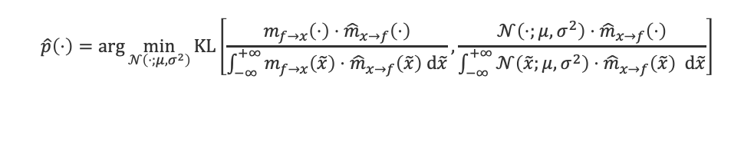
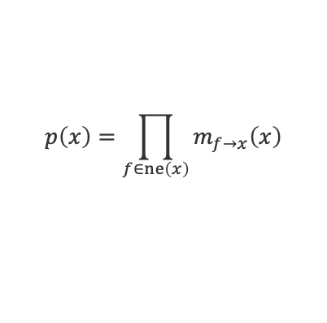
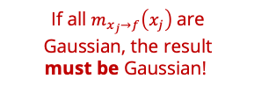
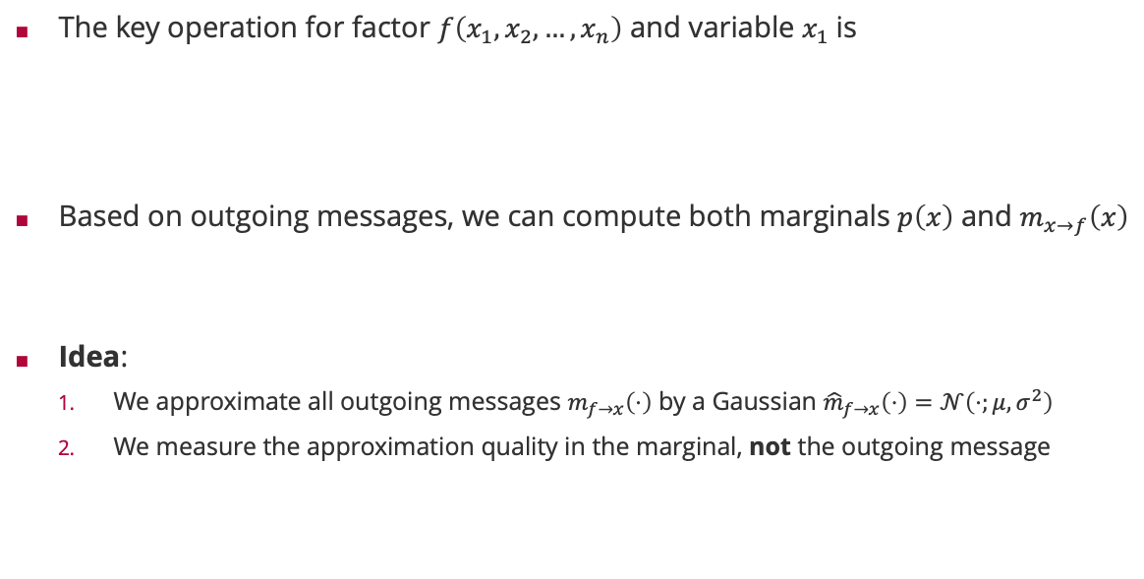
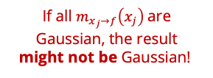

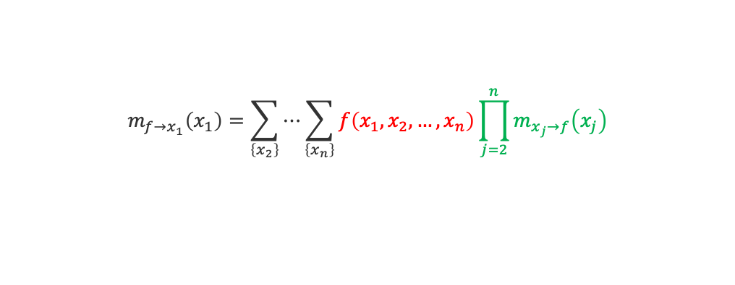
Sum-Product Algorithm Revisited
The key operation for factor $f\left(x_{1},x_{2},…,x_{n}\right)$ and variable $x_{1}$is
Based on outgoing messages, we can compute both marginals $p\left(x\right)$ and $m_{x→f}\left(x\right)$
Idea:
We approximate all outgoing messages $m_{f→x}\left(⋅\right)$ by a Gaussian ${\hat{m}}_{f→x}\left(⋅\right)=𝒩\left(⋅;μ,σ^{2}\right)$
We measure the approximation quality in the marginal, not the outgoing message
$$m_{f→x_{1}}\left(x_{1}\right)=\sum_{\left\{x_{2}\right\}}{⋯\sum_{\left\{x_{n}\right\}}{f\left(x_{1},x_{2},…,x_{n}\right)\prod_{j=2}^{n}{m_{x_{j}→f}\left(x_{j}\right)}}}$$
If all $m_{x_{j}→f}\left(x_{j}\right)$are Gaussian, the result might not be Gaussian!
$$p\left(x\right)=\prod_{f∈ne\left(x\right)}{m_{f→x}\left(x\right)}$$
$$m_{x→f}\left(x\right)=\frac{p\left(x\right)}{m_{f→x}\left(x\right)}$$
If all $m_{x_{j}→f}\left(x_{j}\right)$are Gaussian, the result must be Gaussian!
$$\hat{p}\left(⋅\right)=\arg{\min_{𝒩\left(⋅;μ,σ^{2}\right)}{KL\left[\frac{m_{f→x}\left(⋅\right)⋅{\hat{m}}_{x→f}\left(⋅\right)}{\int_{−∞}^{+∞}{m_{f→x}\left(\tilde{x}\right)⋅{\hat{m}}_{x→f}\left(\tilde{x}\right) d\tilde{x}}}, \frac{{𝒩\left(⋅;μ,σ^{2}\right)⋅\hat{m}}_{x→f}\left(⋅\right)}{\int_{−∞}^{+∞}{{𝒩\left(\tilde{x};μ,σ^{2}\right)⋅\hat{m}}_{x→f}\left(\tilde{x}\right) d\tilde{x}}}\right]}}$$
True marginal with approximate incoming message
Approximate marginal with approximate incoming message

Slide 29
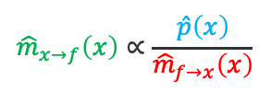
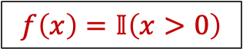
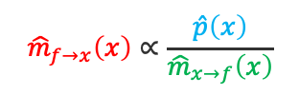
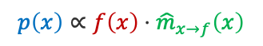
Approximate Message Passing: Example
$$f\left(x\right)=𝕀\left(x>0\right)$$
$${\hat{m}}_{x→f}\left(x\right)∝\frac{\hat{p}\left(x\right)}{{\hat{m}}_{f→x}\left(x\right)}$$
$${\hat{m}}_{f→x}\left(x\right)∝\frac{\hat{p}\left(x\right)}{{\hat{m}}_{x→f}\left(x\right)}$$
$$p\left(x\right)∝f\left(x\right)⋅{\hat{m}}_{x→f}\left(x\right)$$
$$\hat{p}\left(x\right)=𝒩\left(x;E_{X∼p\left(x\right)}\left[X\right],{var}_{X∼p\left(x\right)}\left[X\right] \right)$$

Slide 30

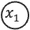
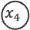
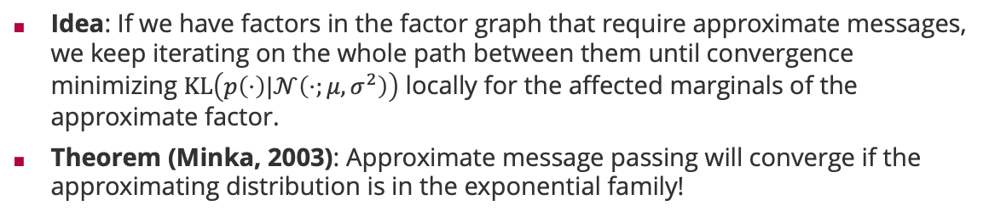
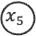
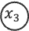
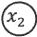
Expectation Propagation
Idea: If we have factors in the factor graph that require approximate messages, we keep iterating on the whole path between them until convergence minimizing $KL\left(p\left(⋅\right)|𝒩\left(⋅;μ,σ^{2}\right)\right)$ locally for the affected marginals of the approximate factor.
Theorem (Minka, 2003): Approximate message passing will converge if the approximating distribution is in the exponential family!
Tom Minka
1
1
1
$$x_{1}$$
$$x_{2}$$
$$x_{5}$$
8
4
7
8
2
5
$$x_{3}$$
$$x_{4}$$
3
6
iterate until convergence

Slide 31
Viel Spaß bis zur nächsten Vorlesung!

